Slide 1


Coping with caregiving 2.0 Suite
Working with
Challenging
Behaviors
II
Notes:
OAC: Behavioral Log
OAC: Behavioral Log Reminders
Rev 5.1.23 AB

Slide 2



Today’s Topics
Changing
Challenging
Behavior
Proposed
Changes
Challenging
Behavior &
Things to Try

Slide 3
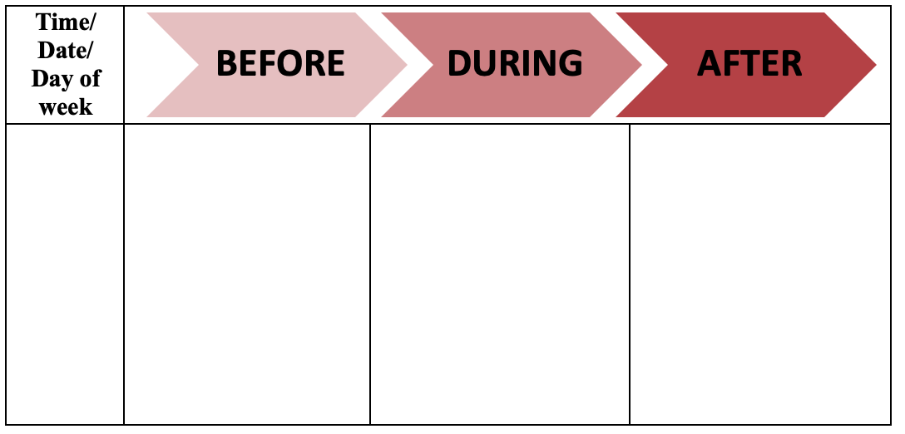
Reviewing the BDA

Slide 4
Changing Challenging Behavior
We will now discuss the different ways we can change behaviors. These include the following:
  Changing the BEFORE or trigger
  Changing what comes AFTER or our reactions
  Changing the trigger and our reactions
Remember the key point discussed earlier?
A person with memory problems has a lot of difficulty learning new information.
The only things you as a caregiver have
control over are triggers and reactions.

Slide 5
Rule Outs
Before we begin with a new example, we need to discuss ruling out medical problems. Before trying to change the person you are caring for’s challenging behaviors, it is important to make sure that their behavior changes are not related to a medical problem.
Some common medical problems that can affect behavior include:
  Medical conditions (e.g., urinary tract infection, constipation, pain, fever)
  Medication side effects (have they started a new medication?)
  Sensory impairments (e.g., hearing loss, poor vision)
It is important that these conditions, as well as others, be adequately diagnosed and treated by your physician, as there may be underlying sources of their behavior problems.
Important Note: Always contact your loved one’s physician if there is any sudden change in the person you are caring for’s functioning.

Slide 6
Remember Betty & Jane?
First topic
Yada yada
Yada
Yada
yada
Yada
yada
Almost every night around 3am
Betty wakes at 3am
Jane is sleeping
Betty doesn’t go back to sleep
Betty wanders around the house
Jane tells her Mom to go to sleep
Jane yells
Betty cries

Slide 7
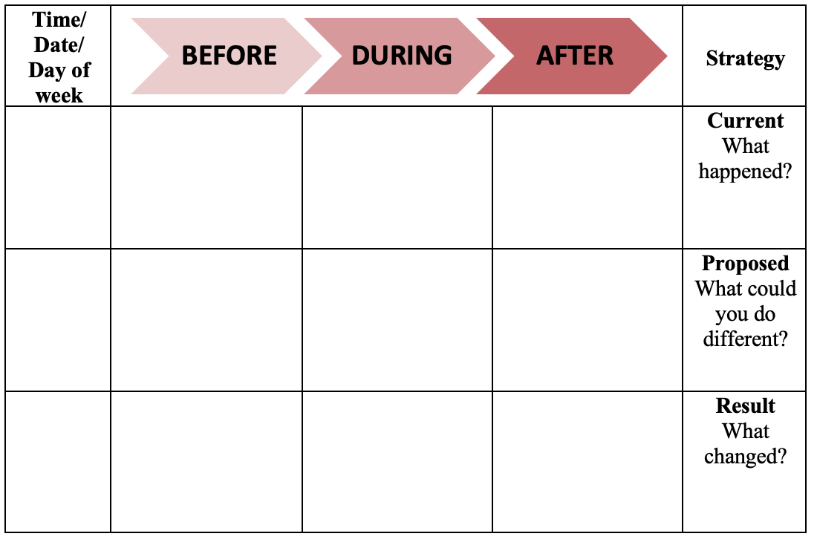
Making Room for Change

Slide 8
Proposed Changes for Before
Almost every night around 3am
Betty wakes at 3am
Jane is sleeping
Betty doesn’t go back to sleep
Betty wanders around the house
Jane tells her Mom to go to sleep
Jane yells
Betty cries
No naps
Keep her busy
Exercise
Bedtime routine
No caffeine
Talk to doc: rule out/ meds

Slide 9
Proposed Changes for After
Almost every night around 3am
Betty wakes at 3am
Jane is sleeping
Betty doesn’t go back to sleep
Betty wanders around the house
Jane tells her Mom to go to sleep
Jane yells
Betty cries
No naps
Keep her busy
Exercise
Bedtime routine
No caffeine
Talk to doc – meds
Gently say: it’s dark out, time to sleep
Play soothing music
Focus on the task; Stay calm
Thirsty? Hungry?
Bathroom?

Slide 10
What Happened?
Regardless of which behavior and strategies you choose, the most important thing to remember is to be consistent.
Problem solving is a process of trial and error.
Once this problem is solved, another one may develop.
It’s possible that the strategy that you produced may work at sometimes and not others.
Be flexible, patient and creative!

Slide 11


Behavioral Log Reminders: Before
To figure out possible triggers:
  Was the environment quiet or noisy?
    Dark or bright?
  Were they alone or was someone present?
    If so, who?
  Was an event occurring, such as bathing, or administering medications?
  Do they want something, such as food, a beverage, or keys?
  Do they appear to be seeking attention?
    If so why? Are they in pain?
V

Slide 12

Behavioral Log Reminders: After
To figure out your reaction:
  Did you stop the event?
    Such as bathing, administering medications
  What kind of feelings did you experience?
    Did your level of stress increase or decrease?
  What did you actually do?

Slide 13

Behavioral Log Reminders: Strategies
Reminders for strategy:
  Could there be a medical problem?
  Have you called the doctor?
  Be creative
  Exercise instead of sleeping pills
  Music instead of a sedative
  Do you need a break?
  Can you ask someone to give you some time to recharge?
  Remember to look for both trigger and response strategies.

Slide 14
Time to Try Your Challenging Behavior
Every morning at 8 am, Jim and his wife Sue have breakfast. After breakfast, Jim sees car keys on the key hook by the breakfast table, and tells his wife, Sue, “I am going out for a drive.” Sue reminds him that he no longer has a driver’s license and is not permitted to drive. Jim responds by yelling, “I don’t know what you are talking about,” and angrily walks toward the driveway. Sue feels helpless and frustrated.

Slide 15
Challenging Behaviors: General Strategies
See the behavior as a means of communication
  Why is this happening right now?
Be conscious of verbal tone & non-verbal signals you are sending
Avoid punishment, blame, or ridicule
Remain calm, walk away for a moment if you need to
Respond to the emotion over the words
Use distraction when possible
Reduce caffeine
Always check in with the doctor for sudden onset of new behaviors
Don’t rush – allow plenty of time
Use a visual cue, show on your body what you want to do before you touch them
Take a time out when you need it

Slide 16
Challenging Behaviors: Agitation & Aggression
Physically
Non-aggressive
Verbally
Non-aggressive
Physically
Aggressive
Verbally
Aggressive
  general restlessness repetitive mannerisms
  constant requests interrupting
  hitting, kicking
  biting
  screaming, cursing outbursts
Why it happens: fatigue, an over-stimulating environment,
making too many demands, asking them to do something
beyond their abilities, failure at a simple task, uncontrolled pain,
untreated depression, side effect of meds, infection

Slide 17
Challenging Behaviors: Agitation & Aggression
Repetitive Mannerism
What you can try:
Have a daily routine
Daily walks
Give them something to fidget with
Distraction
Constant Requests
What you can try:
Stay calm
Not seeking information, looking for reassurance
Use a white board for common questions
Hitting
What you can try:
Do not confront or try to talk about it
Do not try to touch them
Look for patterns/ triggers
Talk to doctor
Outbursts, Screaming
What you can try:
Don’t ignore or talk over them
Avoid topics / change topic
Calm the environment / play music
Look for patterns/ triggers

Slide 18
Challenging Behaviors: Wandering
What it is: Shadowing, repeated looking for cg, aimlessly walking, repeated attempts to leave the house, usually a combo of disorientation and restlessness
Why it happens: an attempt to leave, following someone out the door, bored or lack of stimulation, restlessness due to meds
What you can try:
Keep coats/keys/purse out of sight
Have a safe place and time to walk
ID bracelet/dog tags
Escape proof the house
Exercise
Redirect wandering to a new activity
Reduce noise and confusion
Keep a recent photo handy in case

Slide 19
Challenging Behaviors: Losing Inhibitions
What it is: impulsive and inappropriate behavior – euphoria, self-harm, intrusiveness, sexual inappropriate behavior
Why it happens: an exaggeration of a life-long pattern, thinking someone is their partner, misinterpreting personal care, long for intimacy
What you can try:
Don’t over-react – it’s part of the disease
Respond with patience and a gentle matter-of-fact manner
Reassure and comfort anxious person
Provide more comfortable clothing
Distraction

Slide 20
Challenging Behaviors: Sundowning
What it is: It’s a group of symptoms that occurring in the late afternoon and early evening. These symptoms, are confusion, anxiety, aggression, ignoring directions, pacing or wandering
Why it happens: fatigue, low lighting, increased shadows, disruption of the body's "internal clock”, difficulty separating reality from dreams
What you can try:
Predictable routine for bedtime, waking, meals and activities.
Limit daytime napping.
Limit caffeine and sugar to morning hours.
Keep the house well lit to reduce shadows
Play familiar gentle music or relaxing sounds of nature, such as the sound of waves.
If sundowning develops quickly – talk with the doctor

Slide 21
Challenging Behaviors: Sleep Disturbances
What it is: wakefulness, disorientation or confusion at night, difficulty returning to sleep
Why it happens: confusion, over-stimulation, and fatigue during the day, fear of the dark, maybe seeking safety/security
What you can try:
Check bed comfort – too hot? Cold?
Reduce light and noise
Add a night light
Provide a reflective strip to bathroom
Keep a regular sleep schedule
Same nighttime routine
No naps after 2pm
Reduce caffeine and/or alcohol
Daily exercise
Soft music
Dementia clock showing night/day
Offer a soft stuff animal

Slide 22
Challenging Behaviors: Hoarding
What it is: hoarding, hiding, losing things
Why it happens: trying to have some control over their situation, paranoia – someone is trying to take things away, protecting their property
What you can try:
Create a hoarding box/drawer for them
Figure out where they tend to hide things
Don’t leave anything important out
Keep a spare set of keys or glasses
If hiding food, check their hiding place regularly
Use locks to keep meds safe
Have mail delivered out of reach
Restrict access to trash cans
Prevent access to firearms, power tools, sharp knives, anything dangerous

Slide 23
Challenging Behaviors: Paranoia / Accusing
What it is: suspicious of those around them, accusations of theft and betrayal
Why it happens: confusion and loss of memory can cause suspicion, watching violent movies or TV can also contribute
What you can try:
Don’t argue
Offer simple answers
Distract with another activity
Keep duplicates of favored item
Let them carry small amounts of money
Explain to others that paranoia is part of the disease
Help to look for missing item
Don’t take it personally
Talk to their doctor as medications may help

Slide 24
Take Away
It is important to rule out medical conditions by speaking with their doctor as a possible change of the challenging behavior, especially if the behavior is new and onset was sudden.
The only things you as a caregiver have control over are triggers and reactions.
It is important to keep track of what happened to your proposed strategies, so you have a record of what worked AND what didn’t.
Problem solving is a process of trial and error. Be flexible, patient and creative! Give yourself the gift of time, and permission to fail.

Slide 25

Making This Work for You
Pick One
Pick two or three different strategies
to try when trying to work with a challenging behavior. Keep a log to
track which one worked best.
Try identifying the different parts of
the challenging behaviors you are
struggling with. Note the triggers that occur in the before and note the reactions that happen after.
Set a Deadline
Why this one?
What will you pair it with?
Break it Down
Smaller Steps
Start Date and End Date
Reminders
Be realistic in your deadline.
How will this help you?
Do it with something you already do.
Take a large task and break it into step.
Make large steps into smaller steps.
For each step small or large, use a calendar
Use your computer or phone.

