Slide 1


Coping with caregiving 2.0 Suite
Working with
Challenging
Behaviors
I
Notes:
OAC: The BDA
Rev 5.1.23

Slide 2





Ground Rules
TIME
PARTICIPATION
90 minutes long
May need to interrupt
Is voluntary but,
Best way to learn
PRIVACY
SURROUNDINGS
Said in the group,
Stays in the group
Check screen visibility,
Reduce noise
IF DUTY CALLS
Leave to do what you need
Come back when you can

Slide 3

Introductions
Your Name
One thing you hope to learn today
Who you are caring for and their diagnosis

Slide 4



Today’s Topics
Challenging
Behaviors
Anatomy
of Behavior
Step by Step
Examples

Slide 5
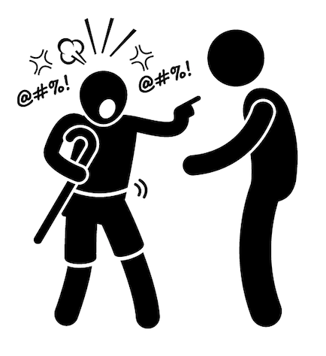
What are Challenging Behaviors?
Cause distress to both caregiver and person being cared for
Aggression (either physical or verbal), agitation, apathy, wandering, sleep disturbances, inappropriate sexual behavior, paranoia, etc.
Not “behaving badly”
  Direct result of changes in brain
  Caused by a general health issue (pain, dizziness, etc.)
  Communication an unmet need (hunger, thirst, lights too bright, etc.)

Slide 6
The Three Parts of Behavior
Before
During
After

Slide 7



Before the Behavior
Identifying the triggers:
An event or activity
Something that affects a person over a long period of time
Cues in the environment

Slide 8
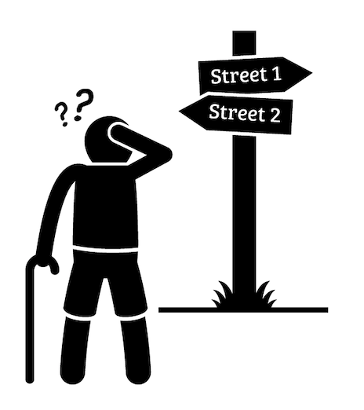
During or the Behavior
The Behavior is what the person who you are caring for does
Be very specific and detailed, no vague terms
Identify exactly what they did or said

Slide 9
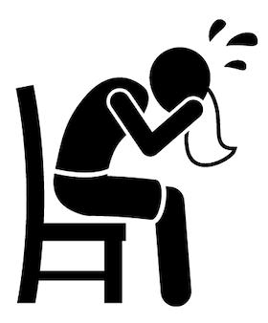
After the Behavior
Reactions occur immediately after the behavior
  Reactions include:
    What you do, how you feel
    What the person who you are caring for does
  In other words, what happens after the behavior?
It is very important to pay attention to reactions Depending on how you react, you may increase or decrease the problem behavior

Slide 10
Key Point
A person with memory problems has a lot of difficulty learning new information. For example, it is difficult to teach him/her the difference between right and wrong behavior.
The only things you as a caregiver have
control over are triggers and reactions.
Occasionally, we can’t change the triggers. During those times, changing how you react to the behavior will keep the situation from getting worse.

Slide 11
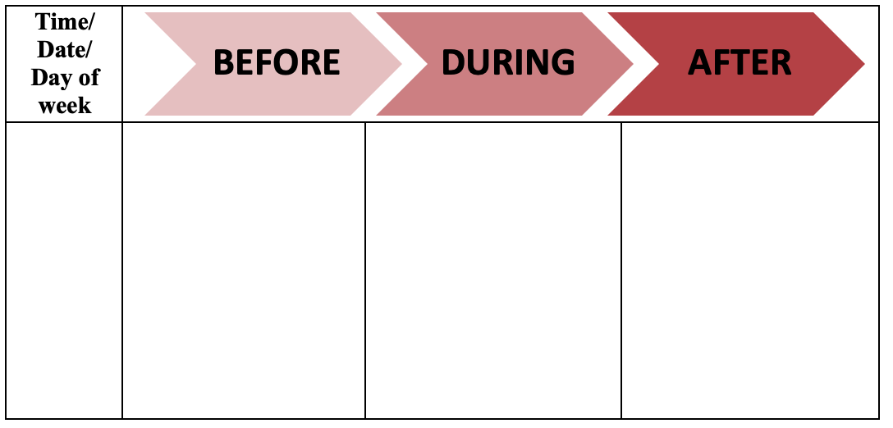
The BDA

Slide 12
Roger & Ginger: Scenario
It is 10 am on Monday morning, and Ginger is quietly sitting in her favorite chair when her son, Robert, comes over to her side and says, “It’s time to go to the doctor, let’s put your coat on.” Ginger says, “No, I’m not going to the doctor.” When Robert pleads for her to get up, Ginger starts to yell. Robert feels overwhelmed since this has happened over and over before. Robert cancels the appointment and leaves Ginger alone in her chair. Ginger stops yelling. Robert completes the following behavioral log.

Slide 13
Roger & Ginger: BDA
Monday
10am
Robert
Mom is quietly sitting in her chair
Robert tells her it is time to go to the doctor
Mom yells when Robert tells her she has a doctor’s appointment and needs to get ready
Robert leaves Ginger alone and cancel’s the doctor’s appointment

Slide 14
Jim & Sue: Scenario
Every morning at 8 am, Jim and his wife Sue have breakfast. After breakfast, Jim sees car keys on the key hook by the breakfast table, and tells his wife, Sue, “I am going out for a drive.”
Sue reminds him that he no longer has a driver’s license and is not permitted to drive. Jim responds by yelling, “I don’t know what you are talking about,” and angrily walks toward the driveway. Sue feels helpless and frustrated.

Slide 15
Jim & Sue: BDA
Every morning
After breakfast
Have breakfast
Says he is going for a drive
Grabs the keys
Sue feels helpless
and frustrated
Sees the keys
Nothing is said about
what happens to Jim
Reminds him he
shouldn’t drive
He yells and walks out

Slide 16
Jane & Betty: Scenario
It is 3 am and Betty wakes up and begins to walk around the house. Jane, her daughter, is sleeping. Betty paces throughout the house and wakes Jane up. Jane is upset because she has a long day at work tomorrow.
Jane says, “Mom, you need to go back to bed, it is 3 am.” Betty says, “I am not sleepy.” Jane yells “I can’t take this anymore.” Betty starts to cry.

Slide 17
Jane & Betty: BDA
First topic
Yada yada
Yada
Yada
yada
Yada
yada
Almost every night around 3am
Betty wakes at 3am
Jane is sleeping
Betty doesn’t go back to sleep
Betty wanders around the house
Jane tells her Mom to go to sleep.
Jane yells
Betty cries

Slide 18
Review BDA
BEFORE
What happens before the behavior
DURING
This is the challenging behavior
AFTER
The reaction to the challenging behavior

Slide 19


Behavioral Log Reminders: Before
To figure out possible triggers:
  Was the environment quiet or noisy?
    Dark or bright?
  Were they alone or was someone present?
    If so, who?
  Was an event occurring, such as bathing, or administering medications?
  Do they want something, such as food, a beverage, or keys?
  Do they appear to be seeking attention?
    If so why? Are they in pain?
V

Slide 20

Behavioral Log Reminders: After
To figure out your reaction:
  Did you stop the event?
    Such as bathing, administering medications
  What kind of feelings did you experience?
    Did your level of stress increase or decrease?
  What did you actually do?

Slide 21
Take Away
Challenging behaviors have a large effect on caregivers and the people they care for.
Behavior has three parts: what happens before the behavior, the behavior itself, and the reactions to the behavior after.
The only things you as a caregiver have control over are triggers and reactions

Slide 22
Homework
Spend the next time between this session and the next examining one
challenging behavior the person you are caring for has.
Break down the behavior to Before, During, and After.
Bring it with you to the next session where we will work on
how to change the behavior.

