Slide 1


Coping with caregiving 2.0 Suite
Filling the Well
Notes:
Handouts
NIH: A Good Night's Sleep
OAC: Self Care Checklist
Rev 5.8.23

Slide 2





Ground Rules
TIME
PARTICIPATION
90 minutes long
May need to interrupt
Is voluntary but,
Best way to learn
PRIVACY
SURROUNDINGS
Said in the group,
Stays in the group
Check screen visibility,
Reduce noise
IF DUTY CALLS
Leave to do what you need
Come back when you can

Slide 3

Introductions
Your Name
One thing you hope to learn from this workshop
Who you are caring for and their diagnosis

Slide 4



Today’s Topics
Caregiver
Burnout
Self-Care
Tips &
Strategies

Slide 5

Let’s Start with the Elephant in the Room
“I have no time.”
“I have no help.”
“I’m just too tired.”
“I just can’t.”
“I can’t afford it.”
Notes:
We know these are real concerns – the job of caring for another person day in and day out can be overwhelming and stressful.
It can seem impossible to fit one more thing into your schedule.
But it’s important to find small, doable ways to keep yourself healthy.
Ask yourself, what will happen to the person you are caring for, if you burnout from all the stress of caregiving?
You are here today because either you, yourself, noted you needed help, or someone you know recommended that you attend.
Try to keep an open mind to the suggestions offered here and focus on the small doable things you can do.
Sometimes it doesn’t matter how much you do but just that you are doing something for you.

Slide 6

Caregiving &Well-being
Love
Commitment
Giving Back
Very Rewarding
Worry
Exhaustion
Continuous Care
Inadequate Resources

Slide 7
Caregiving is Intense
Signs of
Caregiver Burnout
Uncharacteristic Irritability & Impatience
Poor Sleep
Forgetfulness
Physical Symptoms: headaches, gastrointestinal distress
Decreased appetite
Increase food intake
Drinking alcohol too much
Increase drug usage
Isolating
Lack of interest in doing things you use to enjoy
Thoughts of hurting yourself or the person you are caring for
Getting sick all the time
Feeling anxious or depressed all the time
Heavy Workload
Conflicting Demands
Lack of Privacy
Change of Roles
Unreasonable Demands
Unrealistic Expectations
Notes:
• Heavy workload: Most dementias are progressive meaning they get worse over time, increasing in intensity as the disease progresses.
• Conflicting demands: not enough hours in the day to get everything done for everybody: balance the needs of the care recipient, coworkers and employers, family members, and your own needs.
• Lack of privacy: on demand 24/7 means there is little time to be alone.
• Change of roles: caregivers move from child or spouse to caregiver, changing how to relate to the person, grieving for the lost relationship.
• Unreasonable demands: placed upon a caregiver by other family members or the person being cared for.
• Unrealistic expectations: about the effect caregiving efforts will have on loved ones with progressive diseases such as Parkinson's or Alzheimer’s
Review signs of caregiver burnout

Slide 8

Self-Care
A deliberate action
Provides a buffer between you and feeling overwhelmed or stressed
Gives energy to care for someone else
You can’t get water from an empty well
Self-care is not a luxury – it is a necessity!
Notes:
Self-Care is defined as a deliberate action you take that improves your physical, mental, or emotional well-being
This does not mean that you are putting you needs over anyone else’s – it simply means you are relaxing and recovering in order to perform at the best of your ability when you are needed.
Self-Care can lessen the effects of things you normally would find overwhelming or stressing.
Certain acts of self-care provide you more energy than they take to do. Exercise is a good example of this.
As you know, your energy is not infinite, once it’s gone it takes time to refill. Proper nutrition, a good night sleep, exercising your body or mind all provide you with a boost to your energy levels, in essence filling the well with more energy than it take to do these things.
Much like the airline attendants who encourage you to put your own mask on first, taking care of you first means you’ll have the energy to take care of everyone else you are responsible for.
Self-care comes in many different forms so let’s look at that next.

Slide 9
Four Areas of Self- Care
Physical
care for your body
Schedule a doctor appt Take a daily walk Try chair yoga Eat more veggies
Mental
exercising your mind
Listen to a pod cast Do a puzzle or play a game Use your non-dominant hand Draw a map of your neighborhood
Spiritual
meaningful action
Say a prayer Spend time in nature Help someone else Mediation
Social
reaching out to others
Call a friend Unfriend a negative person on Facebook Join a support group Greet a neighbor on your walk
Notes:
We’ve broken down self-care into 4 different areas.
Physical means taking care of your body and include things like …
Mental area means doing things that exercise your mind . Some examples are…
Spiritual or doing things that represent meaningful action to you could be things like …
And our final area is social or reaching out to others. Here you’ll find things like …
Most people will find when they look at what they are doing that they are doing well in one or two of these areas but may need to work a bit more in others.

Slide 10
Quality Sleep
Poor sleep effects us in multiple ways
  It becomes harder to focus and pay attention
  Slows reaction time, making for dangerous driving & other safety related risks
  Effects problem solving abilities
  Without enough quality sleep can become more forgetful
During sleep
  Memories are reactivated
  Connections between brain cells are strengthened
  Information is transferred from short to long-term
Caregiving interrupts sleep in many ways
Notes:
How poor sleep impacts our critical thinking abilities:
A National Sleep Foundation poll found that nearly one-third of drivers said they have nodded off or fallen asleep while driving
Research shows that we need good sleep to feed our high-level, innovative thinking and problem solving abilities.
How much sleep do you need?
A persistent myths exists that as we age we need less sleep. This is not true. Teens need less sleep than children and adults need less than teens. By age 18 the recommended amount of sleep is 7-9 hours. This numbers only slightly decrease as we age. For those over the age of 65, the recommended sleep is for 7-8 hours.
Sleep needs are individual and we’ve all heard how people can not only survive but thrive on less than 5 hours a night. It is important to note this is less than 5% of the general population and that most people are actually walking around sleep deprived. So how do you know you are sleep deprived? You many be experiencing the following symptoms¹³:
Feeling drowsy during the day
Routinely falling asleep within only 5 minutes of lying down in bed for the night
Experiencing "microsleeps," which are very brief episodes of sleep while being awake
What happens if you are sleep deprived? It affects:
Your ability to think clearly
To react quickly
Even form memories
Affects mood, leading to irritability & depression¹⁴ and increase anxiety¹⁵
Chronic sleep deprivation increases the risk of high blood pressure, heart disease, obesity, and diabetes
Sleep Drive
Your sleep drive is lowest in the morning when you waking up, and gradually increases as the day progresses.
Napping reduces sleep drive by recharging the energy reserve. Longer naps reduce the sleep drive more than shorter ones. Napping close to bedtime (even briefly dozing off while watching TV) weakens your sleep drive just when it is most needed.
Stated simply, the longer the time that has elapsed since you last slept, the stronger the sleep drive becomes, and the easier it will be to fall asleep.
In some ways the sleep drive is similar to hunger, and napping to snacking. Appetite may be ruined by snacking close to dinner
Sleep hygiene,¹⁸
Avoid long naps: If you must, limit napping to 30 minutes in the early afternoon. Longer naps late in the day can disrupt nighttime sleep.
Stick to a schedule: Get up at the same time every day, seven days a week.
Play in the sunlight: Expose yourself to sunlight during the day, which helps set your body clock.
Get moving: Regular physical activity promotes good sleep; it can also help you lose weight, which also can improve sleep.
Restrict what you eat and drink: Avoid caffeine after lunch and don’t eat or drink for three hours before bed to keep from waking up to use the bathroom.
Banish electronics: Keep the bedroom for sleeping, not watching TV or reading or playing games on your smartphone or tablet.
Try a warm bath, warm socks: A regular bath may be beneficial two to three hours before bedtime. Wearing socks to keep feet warm can also help you fall asleep more easily.
No difficult discussions: Keep it peaceful before bedtime. No arguing or discussing touchy, contentious topics.

Slide 11
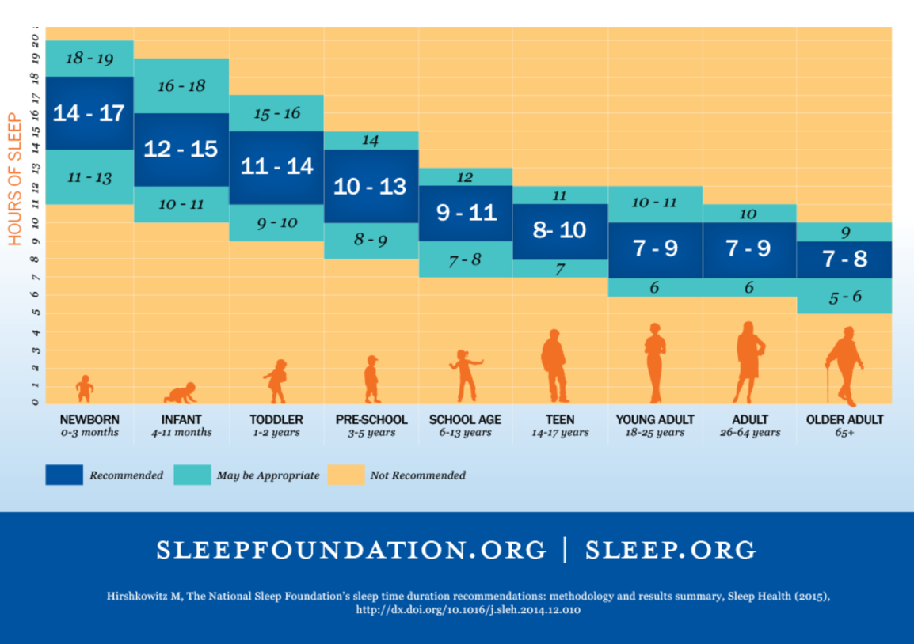
How Much Sleep do You Need?
Optimal Aging Center
Notes:
How much sleep do you need?
A persistent myths exists that as we age we need less sleep. This is not true. Teens need less sleep than children and adults need less than teens. By age 18 the recommended amount of sleep is 7-9 hours. This numbers only slightly decrease as we age. For those over the age of 65, the recommended sleep is for 7-8 hours.
Sleep needs are individual and we’ve all heard how people can not only survive but thrive on less than 5 hours a night. It is important to note this is less than 5% of the general population and that most people are actually walking around sleep deprived. So how do you know you are sleep deprived? You many be experiencing the following symptoms¹³:
Feeling drowsy during the day
Routinely falling asleep within only 5 minutes of lying down in bed for the night
Experiencing "microsleeps," which are very brief episodes of sleep while being awake
What happens if you are sleep deprived? It affects:
Your ability to think clearly
To react quickly
Even form memories
Affects mood, leading to irritability & depression¹⁴ and increase anxiety
Chronic sleep deprivation increases the risk of high blood pressure, heart disease, obesity, and diabetes.

Slide 12
Sleep Hygiene
It’s just another way of saying good sleep habits
Think of it as preparing yourself for for the best sleep you can get
  Avoid long naps
  Stick to a schedule
  Play in the sunlight
  Get moving
  Restrict what you eat and drink
  Banish electronics
  Try a warm bath
  Wear warm socks
  No difficult discussions
Notes:
Sleep hygiene,¹⁸
Avoid long naps: If you must, limit napping to 20 minutes in the early afternoon. Longer naps late in the day can disrupt nighttime sleep.
Stick to a schedule: Get up at the same time every day, seven days a week.
Play in the sunlight: Expose yourself to sunlight during the day, which helps set your body clock.
Get moving: Regular physical activity promotes good sleep; it can also help you lose weight, which also can improve sleep.
Restrict what you eat and drink: Avoid caffeine after lunch and don’t eat or drink for three hours before bed to keep from waking up to use the bathroom.
Banish electronics: Keep the bedroom for sleeping, not watching TV or reading or playing games on your smartphone or tablet.
Try a warm bath, warm socks: A regular bath may be beneficial two to three hours before bedtime. Wearing socks to keep feet warm can also help you fall asleep more easily.
No difficult discussions: Keep it peaceful before bedtime. No arguing or discussing touchy, contentious topics.

Slide 13
Why No Naps?
Sleep Drive
Lowest in the morning after wakening
Increases during the day
Naps weaken sleep drive and make it harder to fall asleep
Notes:
Sleep Drive
Your sleep drive is lowest in the morning when you waking up, and gradually increases as the day progresses.
Napping reduces sleep drive by recharging the energy reserve. Longer naps reduce the sleep drive more than shorter ones. Napping close to bedtime (even briefly dozing off while watching TV) weakens your sleep drive just when it is most needed.
Stated simply, the longer the time that has elapsed since you last slept, the stronger the sleep drive becomes, and the easier it will be to fall asleep.
In some ways the sleep drive is similar to hunger, and napping to snacking. Appetite may be ruined by snacking close to dinner

Slide 14
Benefits of Staying Active
Stress reduction
Better sleep
Improved mood
More energy
Heart disease, stroke, and other disease prevention
Improved memory
Reduction in blood pressure
Increased metabolism
GOAL: 150 mins moderate intensity aerobic activity

Slide 15
Overcoming Barriers to Staying Active
Finding Time
  Combine focused activity with a task already part of your day
  30 mins too long? Break into three 10 min segments
  Can’t do 150 minutes? Some activity is still better than none
Sticking with the Plan
  Mix it up – add new activities from each category
  Find a buddy
Too Tired to Stay Active?
  Increase in energy is one of the many benefits of staying active
  Sometimes you just have to make the plan and “just do it” for a few weeks
  Continuing to feel fatigue after a few weeks? Check in with your doctor
Optimal Aging Center

Slide 16
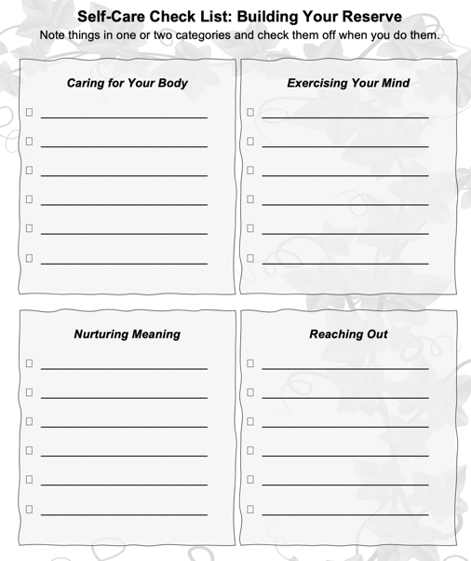
Self-Care Check List
When you are trying to start a new habit it is good to write down your intentions and post them where you can see them every day.
Write down what you want to do
Then check it off when the task is done

Slide 17


What Stops
You From
Self-Care?
Identify attitude or beliefs
Negative Self-Talk

Slide 18

Address Your Health Issues
Find a Support Group
Practice Self-Compassion
Laugh
Notes:
If you find yourself overwhelmed by all of the choices presented in this module then start with these four.
1. Address your own health issues
Ask yourself: what will happen to the person you are caring for if something happens to you? Make a doctor’s appointment, get the physical, get a flu shot, update your glasses prescription, whatever you need to do to be healthy. Research shows you are less likely to see a doctor or prioritize your own medical appointments. No matter how much juggling it takes to get to these appointments, they are important. Someone depends on you to be healthy. If you are up to date on your medical appointments, then are you eating well? Sleeping well? Pick one thing at a time to change. Missing meals can lead to irritability and fatigue, so it is important to eat regularly scheduled meals throughout the day
2. Find a support group.
Nobody knows what you are going through like someone who is in the middle of it also. A support group offers you an opportunity to safety share your worries and concerns knowing that they also share these concerns and worries. There are many support group online now due to the pandemic. Check your local hospital, Alzheimer’s Association, or Facebook.
3. Self-compassion is essential.
Self-compassion means being kind to yourself by giving yourself credit for the tough work of caregiving, ignoring your harsh inner critic, and allowing yourself time to take care of yourself, even if it’s just a few minutes a day.
Two methods of self-compassion for caregivers to encourage:
Change “guilt” to “regret.” Guilt is you did something wrong, regret is that you are in a difficult situation and sometimes you have to make difficult decisions, but they are not wrong.
Forgive yourself—often. You cannot be a perfect caregiver, all day, every day
4. Laugh.
Find ways to keep your sense of humor on a daily basis. Watch comedies, practice laughter yoga, share jokes with friends. Research shows that pretend laughter if done often and long enough turns into real laughter.

Slide 19
Take Away
Caregivers are at an increased risk for certain health concerns and burnout.
Self-Care is a deliberate action you take that improves your physical, mental, or emotional well-being.
Understanding what keeps you from doing self-care can help you to increase the amount of self-care you do.
Prioritizing addressing health concerns, finding support, practicing self-compassion, and adding laughter is a good start on adding self-care to my day.

Slide 20


Making This Work for You
Pick One
Identify Areas to Work On
Use the Self-Care Check List to identify the things you currently do for self-care. Notice which areas you are doing well
in and which areas you need to
work on.
Practice the Top Three
Make a list of your top 3 self-care activities and practice one a day. If needed,
break into smaller tasks.
Set a Deadline
Why this one?
What will you pair it with?
Optional
Break it Down
Reminders
Run into Problems
Getting it Done?
Be realistic in your deadline.
How will this help you?
Do it with something you already do.
Take large tasks & break it into steps.
Phone Alarms
Post-Its
Tape to Mirror
ID the issue
Brainstorm solutions
Try it out

Slide 21

Before you leave,
Please complete our poll.
Notes:
Q1 I found Zoom easy to use for this workshop.
Q2 Overall, I found this workshop to be helpful.
Q3 I plan to use the skills taught in this workshop.
Q4 I believe using these skills will help me to delay placing the person I am caring for in long term care facility.
Q5 I will recommend this workshop to others.

Slide 22

Thank You!
Do you have any questions?
Ann Choryan Bilbrey, PhD
ann@optimalagingcenter.com

