Slide 1


Coping with caregiving 2.0 Suite
Dealing with
the Blues
Notes:
Handouts
OAC: Positive Activities Log (PAL)
Rev 5.8.23 AB

Slide 2





Ground Rules
TIME
PARTICIPATION
90 minutes long
May need to interrupt
Is voluntary but,
Best way to learn
PRIVACY
SURROUNDINGS
Said in the group,
Stays in the group
Check screen visibility,
Reduce noise
IF DUTY CALLS
Leave to do what you need
Come back when you can

Slide 3

Introductions
Your Name
One thing you hope to learn today
Who you are caring for and their diagnosis

Slide 4




Today’s Topics
Caregiving
& Your Mood
Positive
Activities
Going
Forward

Slide 5
Caregiving and Your Mood
Caregiving can lead to depressive symptoms
  Unexpectedly becoming a caregiver
  The intensity of the caregiving
  Severity of the memory loss disorder
It is more common than most realize
  40 to 70% of caregivers have symptoms of depression
Caregiving may make you feel like you
have little to no control over your life

Slide 6
When to be Concerned
When is it a problem?
  Depressive symptoms = some negative feelings
  Depression = 5 or more of these symptoms every day for most of the day for over 2 wks.
  When it starts to effect your functioning it is time to seek treatment
Depressive Symptoms
Feeling sad, empty, irritable or hopeless
Loss of interest or pleasure in activities you used to enjoy
Appetite change – eating more or less
Sleep change – too much or not enough
Restlessness or feeling slowed down
Loss of energy
Feelings of worthlessness
Slowed thinking or loss of concentration
Thoughts of suicide

Slide 7
Taking Back Control with Positive Activities
One way of dealing with the blues is to make time for positive activities
  Evidence-based
  Non-pharmaceutical treatment for depressive symptoms
If all you do is related to caregiving, you may experience:
  Burnout
  Frustration
  Resentment
All which can lead to depressive symptoms
It is the lack of balance between challenging and positive activities in your life that can make you feel like you have no control
– it’s time to add more positive activities!

Slide 8
What are Positive Activities?
They are activities which give you a sense of pleasure, meaning, or purpose
  They can be big or small
  Require some planning as they must be scheduled
  Be done alone or with others
  Can be brief lasting only a few moments or take all day
Examples:
Reading
Going for a walk
Listening to music
Helping a neighbor
Doing a kind act
Meeting a friend
Being creative
Taking a hike
Gardening
Watching children play
Shopping
Planning a trip
Trying out a new recipe
Watching a sunset
Baking
Listening to the bird sing
Doing a puzzle
Visiting a museum
Volunteering
Being needed
Playing a game
Yoga
Smiling at a neighbor
Being creative

Slide 9
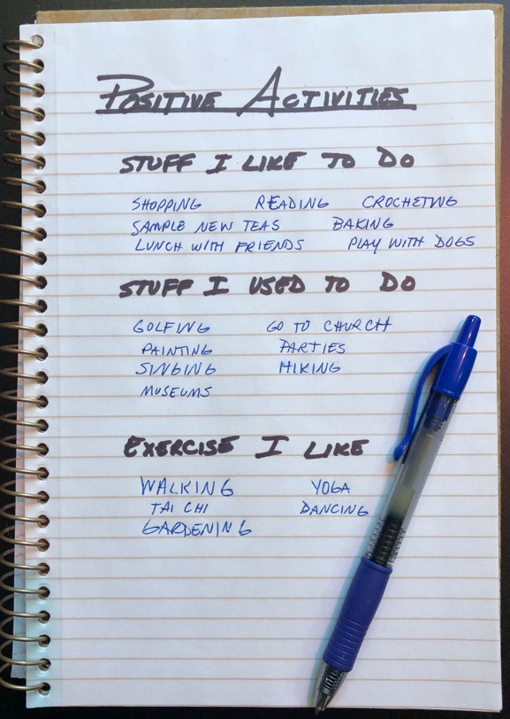
Making the List
How are you currently spending your time?
What did you enjoy in the past?
  Can you do it now?
  Can it be modified to work now?
Brainstorm a list of activities you can do now
  Should be simple and easy to do.
  Have a few items that get your blood moving
  Think about barriers to doing each of these things
  Problem solve and make a plan for the barriers

Slide 10




Importance of Staying Active
Mental Health
  Effective as antidepressants
  Improved sense of well being
  Improve or maintain - some aspects of cognitive function, like your ability to shift quickly between tasks or plan an activity
  Improve sleep
Physical Health
Manage or prevent - arthritis, heart disease, stroke, type 2 diabetes, osteoporosis, and 8 types of cancer, including breast and colon cancer
Goal for these Benefits
150 minutes (2 ½ hours) a week of moderate-intensity aerobic exercise
New to exercise?
https://www.nia.nih.gov/health/exercise-physical-activity

Slide 11
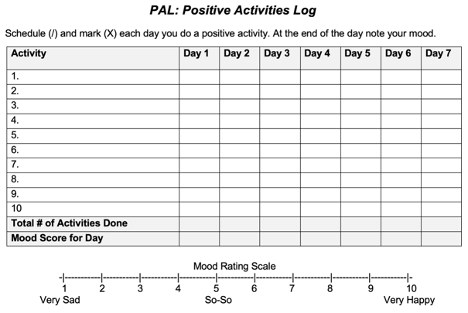
PAL: Positive Activities Log
Move your list to PAL
  On the Positive Activities Log (PAL) you’ll see a numbered list from 1-10, put your top 10 there
Schedule
  Try to schedule at least 4 per day by marking the PAL with a slash for the days you will do them
Do the Task
  During the week as you complete your activity you can add the other slash to make an X

Slide 12

Using this Skill
For effective use of this skill
  Scheduling is an important part of the process - don’t look back over your day and count things you already did. It must be scheduled.
  Don’t wait to do things until you feel like it or wait until you are motivated – just follow the plan and trust the process.
  Research has shown that the best dose for the positive activities is 4 per day to reduce depressive symptoms and maintain their absence.
  It is important to get 4 positive activities
  scheduled into your day and then do them!

Slide 13
Going Forward
REVISING
YOUR LIST
After the first week:
Which activities were done? Which ones were not? What stopped you?
Can the activity be modified?
Should you switch it out for another one?
The goal:
To find 10 activities you can use to lift your mood whenever you need it

Slide 14
Going Forward
FIGURING OUT
YOUR DOSE
You may notice:
  Connection between how many PA in your day and your mood
  Some types of activities may work for you more than others
On average:
  4 positive activities a day keeps the blues away

Slide 15
Take Away
Depressive symptoms are common during caregiving. Taking the time to enjoy yourself will help you feel less stressed and a better caregiver.
Scheduling and then doing positive activities can help to manage mood.
It is important to do the scheduled activity, even if you don’t feel like it. Make a plan and do the plan – trust in the process.

Slide 16




Making This Work for You
Pleasant
Create a list of positive activities
Schedule 4 Positive Activities each day
Do the activities as scheduled
At the end of each day note your
mood rating for that day
Activities
Each week, revise your list until you have a solid 10 you can depend on
Add activities to your schedule whenever you are feeling down or notice you are getting very irritable
Set a Deadline
Why this one?
What will you pair it with?
Optional
Break it Down
Reminders
Run into Problems
Getting it Done?
Be realistic in your deadline.
How will this help you?
Do it with something you already do.
Take a large task and break it into steps.
Phone Alarms
Post-Its
Make Visible
ID the issue
Brainstorm solutions
Try it out

Slide 17

Before you leave,
Please complete our poll.
Notes:
Q1 I found Zoom easy to use for this workshop.
Q2 Overall, I found this workshop to be helpful.
Q3 I plan to use the skills taught in this workshop.
Q4 I believe using these skills will help me to delay placing the person I am caring for in long term care facility.
Q5 I will recommend this workshop to others.

Slide 18

Thank You!
Do you have any questions?
Ann Choryan Bilbrey, PhD
ann@optimalagingcenter.com

