Slide 1


Coping with caregiving 2.0 Suite
All By Myself
Notes:
Handouts
ALZ San Diego: 9 cognitively stimulating activities you can do at home
GeriPal: Staying Connected: Things to Do
Rev 5.1.23 AB

Slide 2





Ground Rules
TIME
PARTICIPATION
90 minutes long
May need to interrupt
Is voluntary but,
Best way to learn
PRIVACY
SURROUNDINGS
Said in the group,
Stays in the group
Check screen visibility,
Reduce noise
IF DUTY CALLS
Leave to do what you need
Come back when you can

Slide 3

Introductions
Your Name
One thing you hope to learn from this workshop
Who you are caring for and their diagnosis

Slide 4



Today’s Topics
Isolation
Staying
Engaged
Support

Slide 5
Isolation
Even before the pandemic, social isolation was a threat to the well-being of older adults
Social isolation and loneliness are considered a “serious public health risks”
Pandemic has made this worse as places where people were able to connect have slowly dwindled
Loneliness is a key risk factor for:
  Alcoholism and drug use
Alzheimer's disease progression
Antisocial behavior
Cardiovascular disease & stroke
Decreased memory and learning
Depression
Increased stress levels
Poor decision-making

Slide 6

Loneliness and Isolation
Loneliness and Isolation are different, although they are often used instead of the other
Social isolation is the absence of social contact
Loneliness is feeling sadness or unease because you’re alone
  Loneliness, according to many experts, is not necessarily about being alone
  Instead, you can feel alone and isolated, even when surrounded by lots of people
  Loneliness is both complex and unique to each person

Slide 7
What is Social Connectedness?
Social connection is when you connect with other people, either in person or remotely
There are three important parts to social connection:
  How often and who you connect with
  The physical or emotional support you get from your connections
  How you feel about your connections
    Whether you feel lonely or a sense of belonging

Slide 8

Creating Social Connectedness
Create a Support Network
Friends, family, peers, professionals
WHY:
This network helps you to feel connected and less on your own
CAUTION:
Diversify! Don’t depend on just one connection point. The more connection points you have the better it can weather any disruptions.

Slide 9
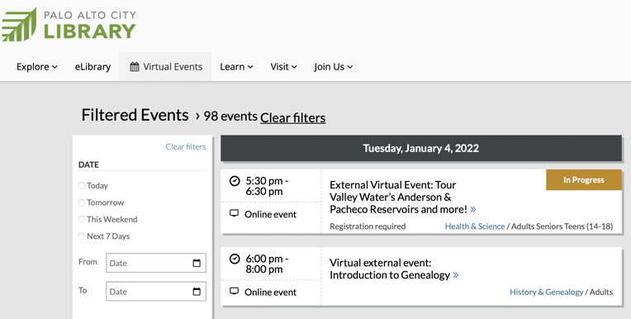
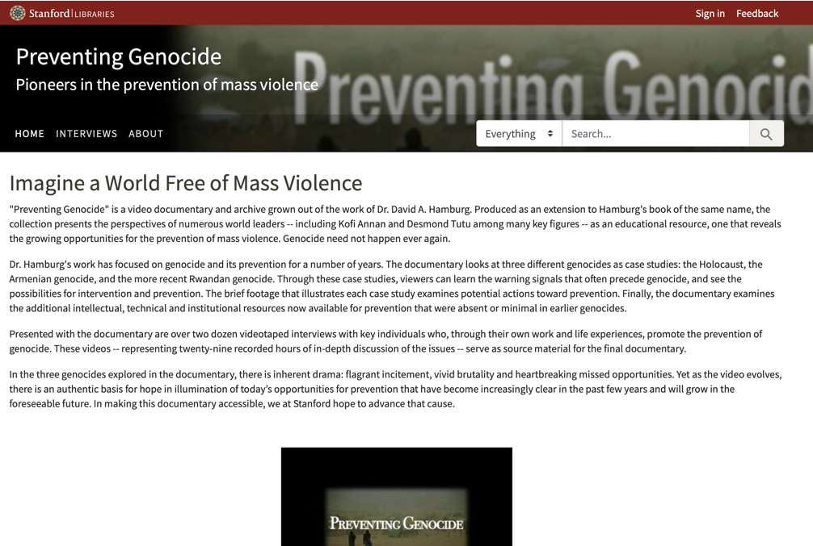
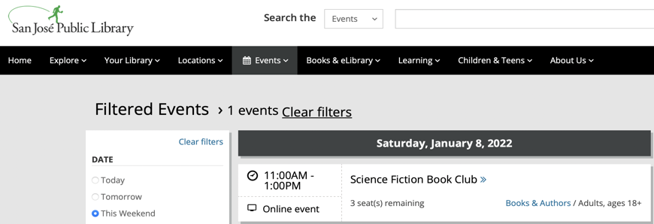

Staying Engaged: Your Local Library
Local libraries have a variety of online offerings
  Book clubs
  Lectures on a variety of topics from science and literature to the practical like navigating Medicare
  Music: hosting a concert to record clubs exploring different artists
  Virtual tours
Many have offerings in other languages

Slide 10



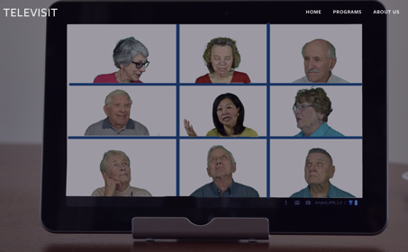
Staying Engaged: Senior Planet & Well Connected
Senior Planet by AARP
For more information:
https://seniorplanet.org/locations/palo-alto/events/
Well Connected by Covia
To download catalog or to check it out: https://covia.org/programs/well-connected/
Televisit (not-for-profit)
For more information:
http://www.televisit.org/

Slide 11








Staying Engaged: Virtual Tours
Come and tour places you’ve never thought you would get a chance to see!
Grab a friend and go for a tour each from your own computer
https://teambuilding.com/blog/virtual-tours

Slide 12


Making Connections Online
Helplines
Online Support Groups
Message Boards
Social Media

Slide 13

Where to go in a Crisis: Helplines / Hotlines
WHAT:
Non-judgmental listening services for people in crisis
Offered by telephone, may also be email, web or text support
Can also offer access to information, services, and advice
WHY:
Sometimes it can be very freeing to talk with someone who is completely objective
Most are 24/7, so in the dead of the night when you are laying awake worrying it is nice to have someone to talk with
CAUTION:
You are not guaranteed to talk to the same person every time

Slide 14
Helplines for Caregivers
Institute on Aging Friendship Line (800-971-0016)
24-hour toll-free Friendship Line
Founded in 1973, it is the only accredited crisis line for people aged 60 years and older, and adults living with disabilities
Alzheimer’s Association 24/7 Helpline (800-272-3900)
24/7, 365 days a year
Specialists and master’s-level clinicians offer confidential support and information
Live chat from https://www.alz.org/help-support/resources/helpline
Caregiver Help Desk (855-227-3640)
Caregiving experts are available 8:00 AM – 7:00 PM ET.
Helps caregivers to find the right information needed to help navigate complex caregiving challenges.
Live chat/email available from https://caregiveraction.org/
Check website of specific chronic illness foundations/associations.

Slide 15

Support Groups
WHAT:
Support groups focus on sharing personal experiences and feelings, coping strategies, or firsthand information
WHY:
Feel less alone
Source of practical advice
CAUTION:
You may need to try out a variety of support groups until you find one that fits you

Slide 16


Support Groups: Pros and Cons
PROs:
Feeling less lonely or isolated
Improving skills to cope with challenges
Improving understanding of a disease
Learning about health, economic or social resources
CONs:
Not helpful for everyone
Many groups do not do problem solving
Some can end up leaving you feeling worse than when you arrived
No way of knowing if material offered is evidence-based

Slide 17

Finding a Group That Fits
Understand the Format
Manage Expectations
Cost Involved
Don’t Have to Stay
Keep an Open Mind

Slide 18
Where to Find a Support Group
Family Caregiver Alliance offers an emailing list style support for caregivers caring for persons with all types of chronic illnesses
https://www.caregiver.org/connecting-caregivers/support-groups/
  Well Spouse Association open for all chronic illnesses https://wellspouse.org/
Looking for something local and in-person?
  Check out the major organizations for the illness of the person you are caring for
  American Heart Association https://www.stroke.org/en/stroke-support-group-finder
    Michael J Fox Foundation https://www.michaeljfox.org/news/support-groups
Alzheimer’s Association https://www.alz.org/events/event_search
Lewy Body Dementia Association https://www.lbda.org/local-support-groups/
Find your local Area on Aging. https://www.n4a.org/

Slide 19
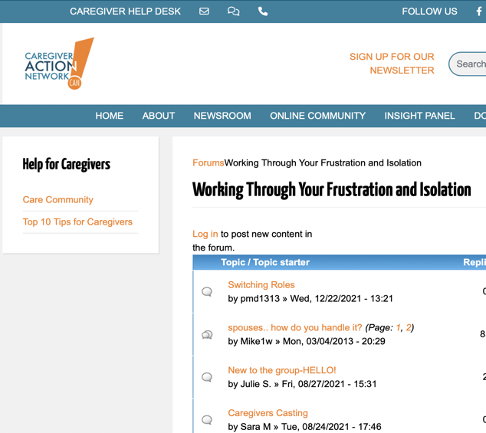
Online Message Boards
WHAT:
Online message boards serves the same goals of a support group without the structure of attending a once a week ‘event’
Available 24/7 you post your question or share an answer on your schedule
WHY:
Along with feeling less alone & being a source of practical advice online message boards are available when you need them
CAUTION:
You don’t know who is offering the advice so make sure you verify the information before you use it!

Slide 20
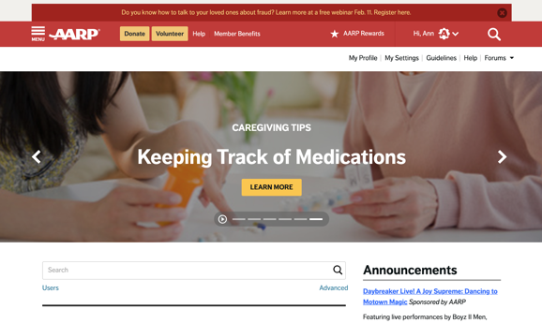
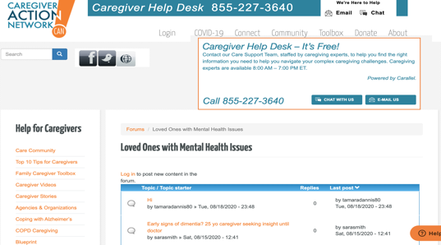
Message Boards
AARP Community
(AARP)
For all caregivers
Don’t have to be a member
Variety of forums including a set specifically for caregivers – caregiver tips, knowledge base articles, chat, plus more
https://community.aarp.org/
ALZ Connected
(Alzheimer’s Association)
Alzheimer’s & other Dementias
Patients, CGs, Family, Friends, and others
https://www.alzconnected.org/
Care Community
(Caregiver Action Network)
Browse without signing up, but to post need to join
Specific forums for Alzheimer’s, Huntington’s, Parkinson’s, & COPD, plus more online forums
https://caregiveraction.org/community
FCA/Smart Patients
(Family Caregiving Alliance / Smart Patients)
For caregivers of adults with chronic physical or cognitive conditions
https://www.smartpatients.com/partners/fca

Slide 21


Social Media - Facebook
WHAT:
Facebook has many private support groups, some have been around for years
Providing support & advice, many caregivers find them very helpful
WHY:
Facebook is a media that many are already familiar with
CAUTION:
There is no guarantee of privacy on Facebook. While these groups do make an effort to protect their members, the very nature of Facebook can at times work against them.

Slide 22
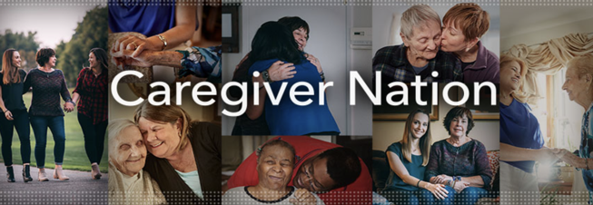

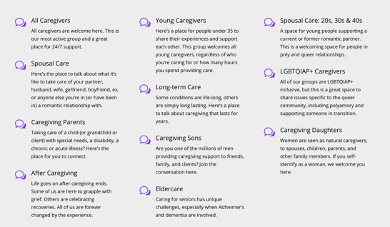
Facebook Caregiver Groups for All Caregivers
Caregiver Nation
For family caregivers to share information, empathy, understanding, and resources to support caregivers.
https://www.facebook.com/groups/122999778390804
Working Daughter
This is for women who are balancing caring for an aging parent with their career.
https://www.facebook.com/groups/workingdaughter/
Caregiver Space Community
Offers a variety of private Facebook groups. Group by specific caregiver type, these private Facebook groups are part of Caregiver Space.org and open to any caregiver.
https://thecaregiverspace.org/

Slide 23
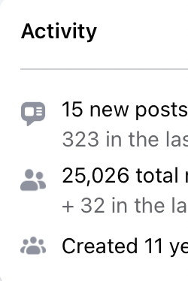

Facebook Caregiver Groups for Dementia
Memory People
They bring real-time Support to patients, caregivers, advocates, family members and professionals who are dealing with Alzheimer’s / dementia or any memory impairment.
https://www.facebook.com/groups/180666768616259?ref=pages_group_cta
The Purple Sherpa Basecamp: Dementia Family Caregiver Support Group
This is a place to share what we've learned as care-partners, to vent and support one another, and to break the silence that leaves so many caregivers feeling alone.
https://www.facebook.com/groups/ThePurpleSherpaBasecamp/

Slide 24
Take Away
Staying socially connected is important to staying healthy, happy, and keep your mind sharp.
There are multiple ways you can stay connected using the internet.
Support Groups come in many shapes and sizes and can help you feel less alone and serve as sources of practical advice.

Slide 25



Making This Work for You
Pick One
Pick One New Activity
to do with others to add
each week to my
weekly schedule
Find a Support Group or Message Board to join. Stay for least a few meetings or a week
to get a feel for the
group or message board.
Set a Deadline
Why this one?
What will you pair it with?
Optional
Break it Down
Reminders
Run into Problems
Getting it Done?
Be realistic in your deadline.
How will this help you?
Do with something you already do.
Take a large tasks & break it into steps.
Phone Alarms
Post-Its
Tape to Mirror
ID the issue
Brainstorm solutions
Try it out

