Slide 1


Coping with caregiving 2.0 Suite
Coping with
Frustration
Notes:
Handouts
OAC: Anger Mapping
OAC: S.T.O.P.
Revised 5.1.23 AB

Slide 2





Ground Rules
TIME
PARTICIPATION
90 minutes long
May need to interrupt
Is voluntary but,
Best way to learn
PRIVACY
SURROUNDINGS
Said in the group,
Stays in the group
Check screen visibility,
Reduce noise
IF DUTY CALLS
Leave to do what you need
Come back when you can

Slide 3

Introductions
Your Name
One thing you hope to learn today
Who you are caring for and their diagnosis

Slide 4



Today’s Topics
Negative
Emotions
Recognizing
Intensity
Strategies
for Managing

Slide 5


Emotions
Sad
Guilt
Happy
Anger
Joy
Emotions
Frustration
Love
Hope

Slide 6


I shouldn’t have said/done that!
Everyone reacts in different ways
  Genetics
  Biology
  Environmental
  Situational
Emotions themselves just are - they are not bad or good

Slide 7


Three Parts to Emotion
How you
feel
How your
body reacts
How you
behave

Slide 8
Range of Anger
FURIOUS
ANGRY
FRUSTRATED
UPSET
ANNOYED
CALM
no
strong emotion
slightly
angry or irritated
unhappy,
disappointed
or worried
upset because
you can’t change
something
strong feeling- someone did you wrong
wild,
intense
anger

Slide 9
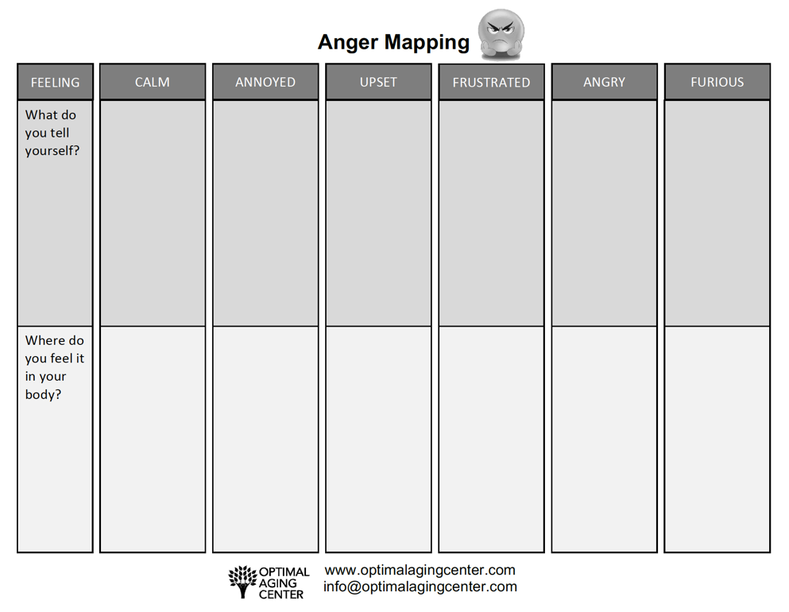




How Do You Know?
Notes:
Some people just know. For those that don’t your body can give you a clue.
(Handout/activity)
Everyone should have a copy of the handout. If not, you can use a pen and paper and following along with what is on the screen.
We tell ourself things when we experience strong emotions.
When we are calm we might say something like: “Life is good right now.”
We note that in our body our shoulders are relaxed, our breathing is measured, neither fast nor slow.
On the other hand, when we are furious we may say something: ”I’m so angry, I hate being a caregiver.”
Our body feels tight and tense, our fists our clenched, our face feels hot.
Facilitators: walk them through filling out annoyed, frustrated, and furious giving them a few minutes for each one.
Note that some caregivers will find it easy to be aware of what they are are thinking in the ‘heat’ of the moment, others will need some assistance. Remind them the cg doesn’t need to share this, that this is for their own awareness and to use as we discuss different methods of coping with frustration and anger.
What we are thinking and what our bodies tell us are both clues to where we are in the range of anger.

Slide 10
Taking 10 Breaths
Giving you space to respond rather than react
FIRST TIME
Sit comfortably in a chair and close your eyes. Notice your breathing. Just observe your own breath for a couple of breaths.
STEP 1: SLOW
Breathe in through your nose for a count of 5, pause
Breathe out through your mouth for a count of 5
STEP 2: TAKE 10
Continue this practice for at least 10 breath cycles (in/out).
STEP 3: REPEAT
If still upset, do another 10 breaths.

Slide 11

Self Talk
What we tell our self when we are angry is powerful
It can mean the difference between handling your anger well or not
It is important to be aware of what you tell yourself
I can’t do this anymore!
He is doing this on purpose.
I’m a horrible caregiver!

Slide 12

STOP
S
T
O
P
Stop
Take 10 Breaths
Observe: What’s happening in me?
Proceed Differently

Slide 13
Proceeding Differently
Annoyed or upset?
Change the self-talk
Find the humor in the situation
Frustrated?
Change the self-talk
Take 10 breaths
Angry or furious?
Walk away
Take 10 breaths
Exercise your anger away
Wait to re-engage until calmer

Slide 14
Take Away
Both positive and negative emotions are a normal pare of caregiving.
Emotions are one part how you feel, one part how your body reacts, one part how you behave.
There are different ways to proceed dependent on how angry you are.
Stop, Take ten breaths, Observe, and Proceed can help to give you space to respond rather than react when you are angry.

Slide 15


Making This Work for You
Pick One
Deep Breathing
Practice taking
10 breaths daily.
Anger-Mapping
Become aware of
your self-talk. Track it for one week and practice finding alternatives.
S.T.O.P.
Use S.T.O.P. during a situation where you are mildly or moderately angry.
Set a Deadline
Why this one?
What will you pair it with?
Optional
Break it Down
Reminders
Run into Problems
Getting it Done?
Be realistic in your deadline.
How will this help you?
Do it with something you already do.
Take large tasks & break it into steps.
Phone Alarms
Post-Its
Tape to Mirror
ID the issue
Brainstorm solutions
Try it out

Slide 16

Before you leave,
Please complete our poll.
Notes:
Q1 I found Zoom easy to use for this workshop.
Q2 Overall, I found this workshop to be helpful.
Q3 I plan to use the skills taught in this workshop.
Q4 I believe using these skills will help me to delay placing the person I am caring for in long term care facility.
Q5 I will recommend this workshop to others.

Slide 17
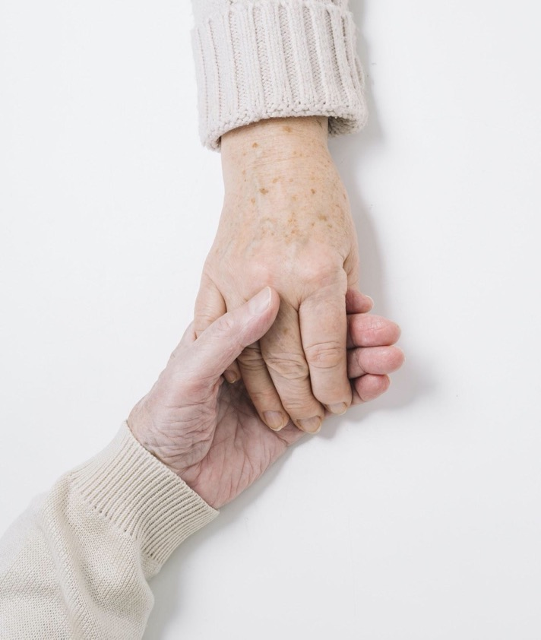
Thank You!
Do you have any questions?
Ann Choryan Bilbrey, PhD
ann@optimalagingcenter.com

