Slide 1


Coping with caregiving 2.0 Suite
Being Heard
Notes:
Handouts
FCA: Saying ‘Yes’.pdf
Women's Alz Movement: Essential Do’s and Don’ts
FCA: Family Meeting.pdf
Updated 6.2.23

Slide 2





Ground Rules
TIME
PARTICIPATION
90 minutes long
May need to interrupt
Is voluntary but,
Best way to learn
PRIVACY
SURROUNDINGS
Said in the group,
Stays in the group
Check screen visibility,
Reduce noise
IF DUTY CALLS
Leave to do what you need
Come back when you can

Slide 3

Introductions
Your Name
One thing you hope to learn today
Who you are caring for and their diagnosis

Slide 4



Today’s Topics
Empathy as
the Foundation
of Communication
Communication
and
Memory Loss
Communication with Family
& Friends

Slide 5
Empathy
Empathy is the ability for someone to put themselves in the shoes of another person so they can feel what that person is feeling
When receiving empathy, the person feels understood, accepted, important, and above all, connected to another person
Empathy is not a fixed trait
it is a skill that can be improved through practice!
Notes:
Memory Loss can make someone:
lose the feeling of being connected to others
Some will react with agitation and some by withdrawing
Empathy
helps caregivers connect
helps care recipients to feel understood and safe

Slide 6
Activity: Experiencing Empathy
Instructions: Imagine yourself in the place of the patient.
You received a phone call from your doctor’s office requesting a clinic visit to discuss results of recent tests.
Arriving at the clinic, you’re insecure and somewhat bewildered because you feel like other people are looking at you and all the background noise is distracting.
When you get in the doctor’s office, the doctor and your caregiver carry on a discussion about your condition while totally ignoring you. You are trying to follow the conversation, but the doctor seems to be talking very fast and you don't quite understand all the words.
Notes:
Instructions: Participants are to imagine themselves in the place of the patient as the facilitator reads the scenario. There will be two discussion points following the scenario: First Reaction and then Points to Consider.
You hear;
“Well, the consummation connote dementia, practicably Alzheimer’s blazon. There’s no expeditiously percipient progress, but exigency is no medicament for Alzheimer’s. I’ll pharmacon Aricept for pother. Inguritate one bolus qhs for a singular stretch of 30 diurnal courses then inguritate 2 bolus qhs. You might endeavor to acquire formation of stanchion to frequent. I cede a practitioner vigilance bangle contingent upon irretrievability. My RN will make an observation of duration to resume in six stretch of 30 diurnal courses. Expression commiseration. There is a nonexistence of resolution to propound.”

Slide 7
Discussion: Experiencing Empathy
Can you figure out what the diagnosis is here?
What about the prognosis?
What instructions have been given?
How did it feel when the doctor and your caregiver discussed your diagnosis as though you weren’t even in the room?
What impact on your thoughts could this have?
What about how you are feeling?
Alzheimer's Disease is mentioned a couple times –
what do you think the reaction would be to that diagnosis?

Slide 8

Communication & Memory Loss
Memory loss affects communication
It’s harder to understand what is said
It’s harder to say what they want to say
It’s harder to find the right words
It’s hard to remember thoughts from one moment to the next
It causes communication problems which can lead to behavior problems
IMPORTANT POINT
Because care recipients cannot change their communication problems, it is important that we find other ways to communicate with them.

Slide 9
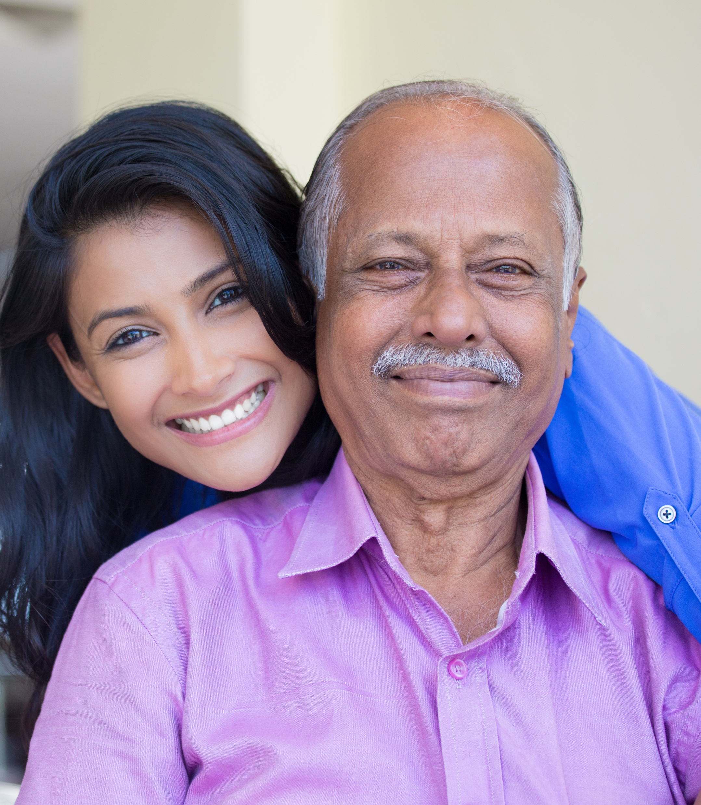
Communication Strategies
Use Open Body Language
Be Aware of Their Body Language
Be Attentive
Listen to Hear, Not to Talk
Use Voice and Words to Convey Empathy
Deal with the Emotion not the Content
Avoid!
Don’t argue with the person you are caring for.
Don’t tell the person what they cannot do.

Slide 10











Getting Help from Friends and Family
Prepare
  Examine your needs
  Who are you going to ask?
Ask
  State the problem
  Use ’I’ Statements
  Don’t be afraid to negotiate
    Break it down into smaller chunks
    Be persistent yet flexible
    Don’t give up!
Follow Through
  Confirm before event
  Prepare emergency info
  Use facts
  Give specific details

Slide 11
Getting Help from Friends and Family
Think of the last time you asked someone for help.
Were you successful?
How hard was this for you to do?
Did you use any of the strategies suggested?
What part did you find easy?
What part did you struggle with?
What can you do to make it easier for you to ask?
What barriers might the person have that you are ask?
Is this something you would do at home with your own family?

Slide 12
Family Meetings-Routine Communications
Who's invited?
Make an agenda before the meeting
Start with any updates on symptoms or new diagnosis and resulting issues
Then problem solve for issues
Make an action plan and make sure everyone understands responsibilities
Not a one time thing
Notes:
Family Meetings-Routine Communication https://www.caregiver.org/resource/holding-family-meeting/
Who's invited?
Decide who should attend
If not available decide who will send a summary
Make an agenda before the meeting
done before the meeting and sent to who is coming so they can add to the agenda
see https://www.caregiver.org/resource/holding-family-meeting/ for an example of an agenda
Start with any updates on symptoms/new diagnosis and resulting issues
can be a doctor's report or an update on daily functioning
note changing needs or developing issues
it is good to make a list but do not move to problem solving until they are all introduced
Then problem solve for issues
use the list generated
note what solution was decided on, who is responsible for it
Make an action plan and make sure everyone understands responsibilities
State the problem
Outline the action steps that will taken to address the problem,
ID the person who is responsible for it
Dates of when they will have it done by
Not a one time thing
To encourage communication, should have regular family meetings

Slide 13

Strategies for Dealing with Family Conflict
Attempt to understand the family member you’re in conflict with
Understand why you are in conflict
Keep yesterday's battles out
Realize they may not be ready
Bring in a professional
Notes:
Strategies for Dealing with Family Conflict
When caring for someone with a chronic illness or memory issue, families are most successful when they work together and have a united plan of action. However that does not always happen. For one reason or another a family may experience conflict which can disrupt the care plan.
The following strategies can help you to deal with conflicts that may arise during the caregiving journey.
Attempt to understand the family member you’re in conflict with.
Put yourself in the family member’s shoes and think about why they are feeling or doing what is creating the conflict.
Try to avoid treating them as you have in the past.
Showing empathy does not mean that you agree with the other person and it does not mean that you have to accept what they are saying. It simply means that you acknowledge the issue and any frustration that goes with it, in order to suggest a reasonable course of action to deal with the situation. By doing this in a calm and reasonable way we can often diffuse a conflict situation and get the other party to work with us to achieve what we are looking for.
Understand why you are in conflict.
What are their expectations? How does what you (or your CR) need/want conflict with it?
Describe in detail you or your CR's needs and wants. Be able to clearly state why.
Use supporting examples, reports, doctor statements, expert information
Keep yesterday’s battles out.
Recognize that family histories and old patterns of coping can surface as family members deal with caregiving situations.
Included in these histories are old patterns or roles of how each individual reacted or coped with stressful situations.
An example of old patterns is a CG who when they were young did not handle stress well. Now they are the cg yet the family treats them like everything they say is just a stress exaggeration and ignoring the fact that since that time the CG has learn more effective methods of coping. Now this old pattern of functioning won’t work as the CG is the one who communicates her parent’s needs with other family members. This requires a new pattern of interaction between family members. This new pattern of interaction requires all family members to change how they view the CG.
Realize they may not be ready.
They may not be able to come to terms with what is happening to the care receiver for many reasons.
Past conflicts, sibling rivalries, or estranged relationships play a role in the person’s ability to cope emotionally.
Sometimes instead of coping with the situation they withdraw and appear as if they don’t care.
Keep in mind that denial is often used as a defense mechanism for lots of reasons including fear, the reality that things aren’t going to be the same, or realization they could lose a loved one. Giving the individual in denial time to adjust will help. Insisting or arguing will only drive the individual away. How much time you give your family members depends on their personality, upbringing, resiliency and relationship with the care receiver.
Bring in a professional
It often helps to invite a neutral outside facilitator to attend
Who? Social workers, case managers, ministers, discharge planners, psychotherapists can either mediate or refer you to someone who can
We have discussed numerous strategies family members can use to address family conflict.
Keep in mind that if one strategy doesn’t work you can always try a different one.
The most important fact to keep in mind is the family will be most successful when they work together to care for the care receiver and have a united plan of action.

Slide 14
Family Conflict Resolution
Make sure everyone is in the loop
Practice effective listening skills
Let any anger subside
Avoid these 4 negative communication styles
Problem Solving Steps
Notes:
Add to resources
Avoid these 4 negative communication styles (https://extension.usu.edu/relationships/research/effective-communication-skills-resolving-conflicts)

Slide 15
Take Away
Empathy is a skill we work on throughout our lifetime.
Caregivers need to shift expectations rather than depend on the person they are caring for to change how they communicate.
Clear and concise information combined with flexibility can give a better outcome when speaking with family and friends
There are strategies that can help with family conflict: increased communication, family meetings, or professional mediator.

Slide 16


Making This Work for You
Pick One
Practice Your Empathy
Stretch your mind and practice walking in another’s shoes. What if you woke up one morning in the body and the life of someone else? Find a stranger and imagine what this would be like. What would it feel like to be them? How would you cope? Do next?
Reaching Out to Family or Friends
Using the skills learned here, reach out and ask someone for help in a caregiving task. Whether it is to give you time to get a task done, to handle paperwork you just can’t wrap your mind around, or to visit so you can get a break.
Set a Deadline
Why this one?
What will you pair it with?
Optional
Break it Down
Reminders
Run into Problems
Getting it Done?
Be realistic in your deadline.
How will this help you?
Do it with something you already do.
Take a large task and break it into step.
Phone Alarms
Post-Its
Make Visible
ID the issue
Brainstorm solutions
Try it out

Slide 17

Before you leave,
Please complete our poll.
Notes:
Q1 I found Zoom easy to use for this workshop.
Q2 Overall, I found this workshop to be helpful.
Q3 I plan to use the skills taught in this workshop.
Q4 I believe using these skills will help me to delay placing the person I am caring for in long term care facility.
Q5 I will recommend this workshop to others.

Slide 18
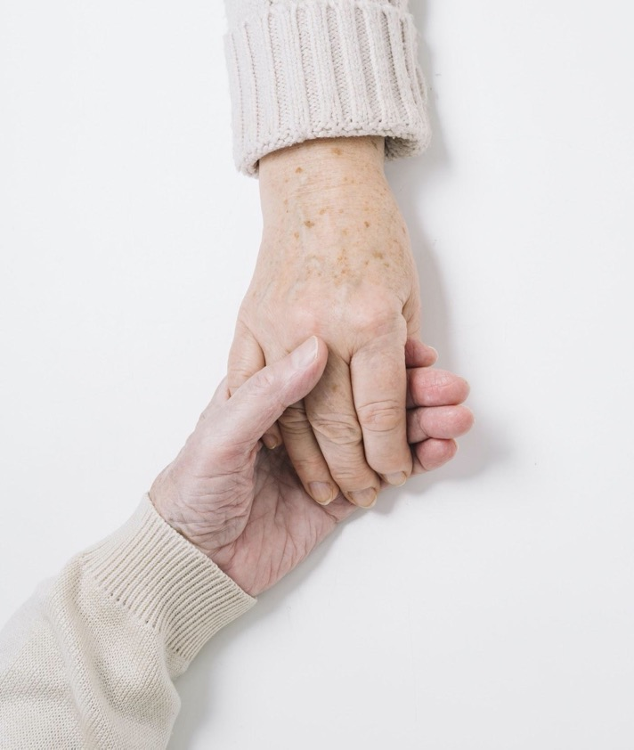
Thank You!
Do you have any questions?
Ann Choryan Bilbrey, PhD
ann@optimalagingcenter.com

