Slide 1


Coping with caregiving 2.0 Suite
Bouncing Back
Notes:
Handouts
OAC: Three Paths
Atlas: CareMap
Atlas: CareMap-Ask Yourself
Revised 5.8.23 AB

Slide 2





Ground Rules
TIME
PARTICIPATION
90 minutes long
May need to interrupt
Is voluntary but,
Best way to learn
PRIVACY
SURROUNDINGS
Said in the group,
Stays in the group
Check screen visibility,
Reduce noise
IF DUTY CALLS
Leave to do what you need
Come back when you can

Slide 3

Introductions
Your Name
One thing you hope to learn today
Who you are caring for and their diagnosis

Slide 4



Today’s Topics
Defining
Bouncing Back
Finding Balance
in your Day
Your
Support Team

Slide 5

Bouncing Back
Part of what helps you to bounce back is resilience
Skills associated with resilience are:
Developing & maintaining supportive relationships
Making realistic plans & following them
Communicating clearly
Skills in problem solving
Your confidence in your ability to use these skills

Slide 6
Creating Balance
Caregivers have trained themselves to be prepared
  Watching the next crisis
  Slowly becomes the first and sometimes only thing you see
  Ignore the positive
However the mind can be retrained
Changing your view of the world
  Broadening view to make room for the positive again
  Just be happy? How?

Slide 7



Creating Balance
Gratitude
Giving Thanks
Helps us to focus on the good things Encourages us to feel positive emotions
Kind Act
Doing for Others
Helps you feel good about yourself Reminds you to take care of yourself
Positive Experience
Something Nice
Impacts current mood Changes future expectations

Slide 8
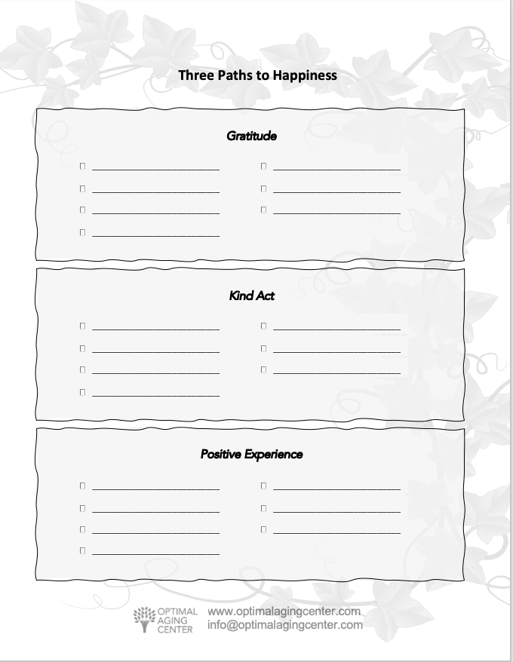
Three Paths to Happiness
Two minutes a day for 21 days in a row
Write down 3 things:
  A Gratitude
    something you give thanks for
  A Kind Act
    something nice you’ve done for someone
  A Positive Experience
    something good that has happened to you
Review at the end of each week

Slide 9
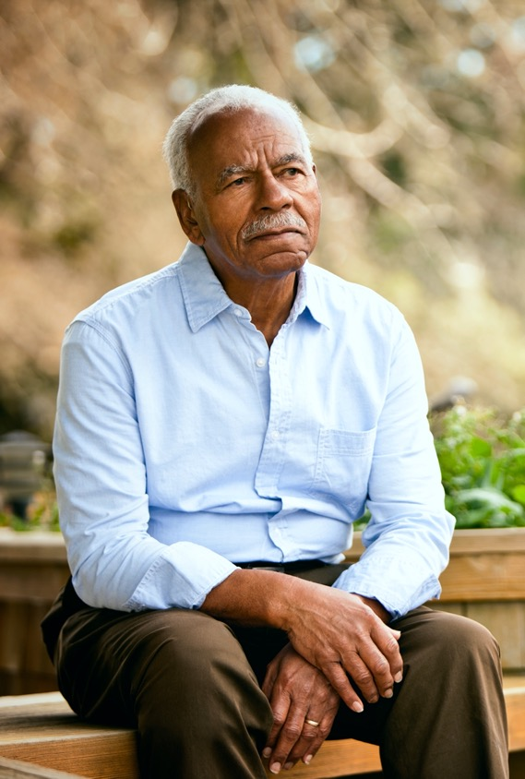
Looking at Your Support Team
Important for bouncing back
  Ability to develop & maintain supportive relationships
  Without relationships you are at risk for isolation
Atlas CareMap
  Identify who is part of your care team
  Drawing your family’s care ecosystem

Slide 10






Why Draw a CareMap?
Appreciate what is working well
Plan for potential difficulties
Manage your team
Identify missing people or areas
Communicate with everyone

Slide 11


Looking at Your Support Team
ACTORS
LINKS
PLACEMENT
People
Pets
Professionals
Places
Arrows that connect
Who cares for whom
Frequency of care
How far away
they live

Slide 12
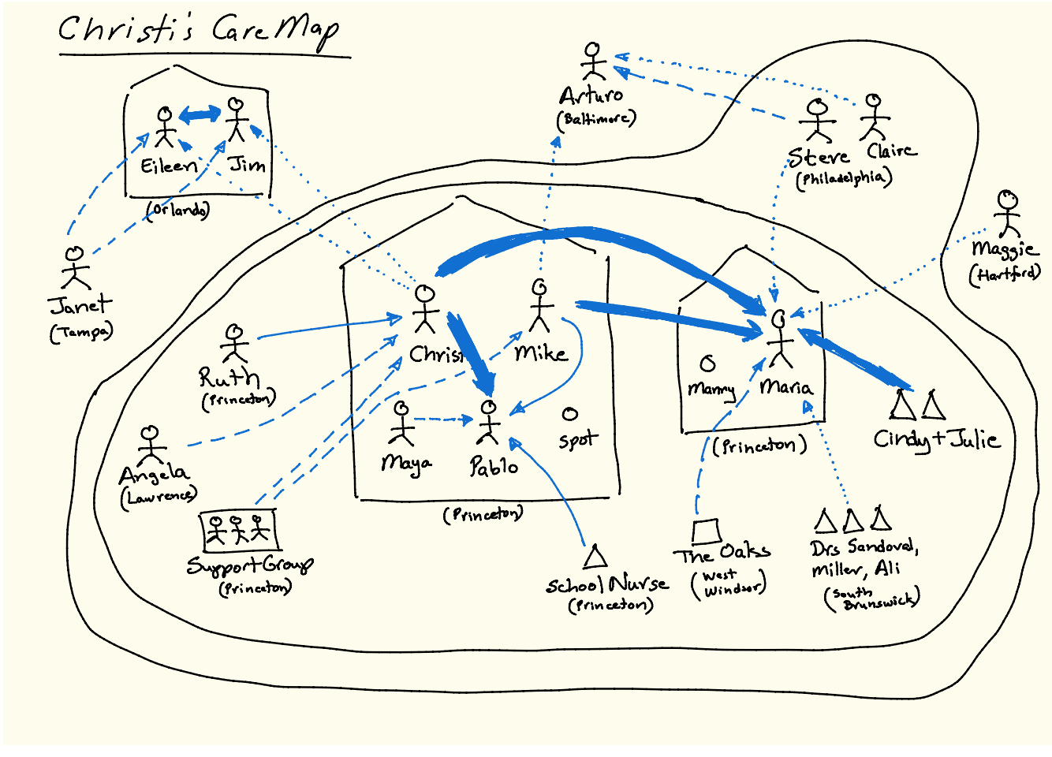
E
X
A
M
P
L
E

Slide 13
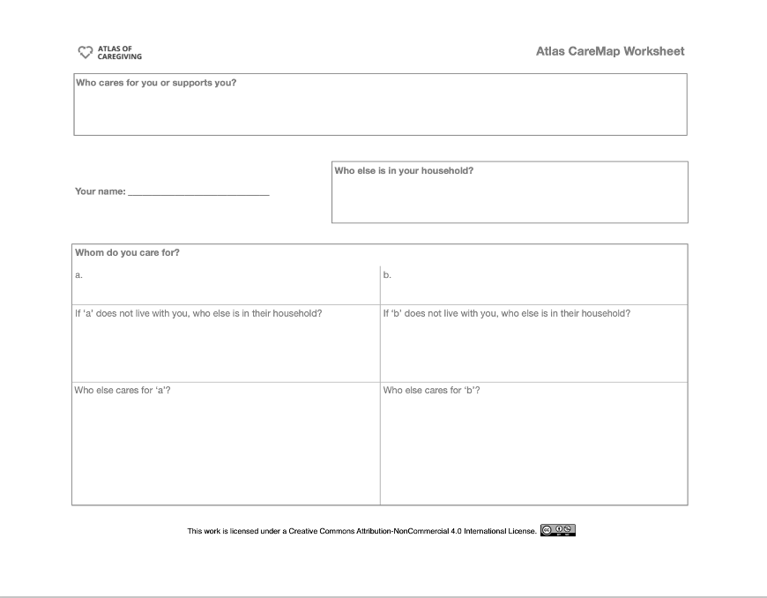

Slide 14

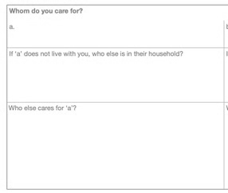

Atlas CareMap Step By Step
Who lives with you?
Put their names here.
Pets too!
Who do you care for, &
who else cares for them?
Enter the names of the people you care for
Enter the names of those who live with them
Enter the names of whoever else cares for them
Who cares for or supports you?
Put the names down of those that give you emotional support or provide time so you can get stuff done.

Slide 15
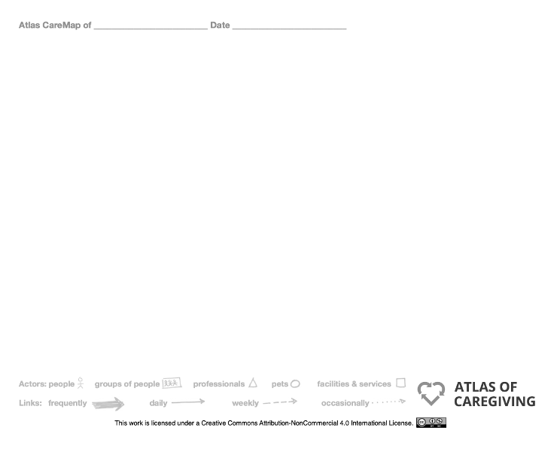


Slide 16

Atlas CareMap
Step By Step
1
Enter your name and date at the top of the drawing sheet.
2
Me
Hubby
Draw yourself and the other Actors who live with you in the middle of the page.
Be sure to write their names.
Then draw a house around this group
and enter the location.
Spot
Mom
Palo Alto

Slide 17



Atlas CareMap
Step By Step
Brother
S-i-L
Bend, OR
3
Draw the Actors you care for
& those who live with them.
Draw them near you or
near the edges of the paper
depending on how far
away they are.
Me
Hubby
B-i-L
Spot
Niece
Mom
Palo Alto
Campbell

Slide 18



Atlas CareMap
Step By Step
Brother
S-i-L
Bend, OR
4
Draw Links to show who you care for.
Remember the arrow goes from you to them and draw the type of arrow that reflects how frequently you care for them. (see bottom of sheet).
Me
Hubby
Sister
B-i-L
Spot
Niece
Mom
Palo Alto
Campbell

Slide 19





Atlas CareMap
Step By Step
Brother
S-i-L
Bend, OR
5
Next draw other Actors
who care for those you care for,
and their Links.
Doctors,
Organizations,
Friends,
Clubs
Eye Dr
Me
Hubby
Sister
B-i-L
Dr. Sam
Spot
Niece
Mom
Palo Alto
Campbell
Rosary Club
Sue

Slide 20



Atlas CareMap
Step By Step
Brother
S-i-L
Bend, OR
Dr Bill
Support
Grp
6
Bob
Draw the Actors who care for
or support you, and their Links.
Friends,
Neighbors,
Agencies,
Support groups,
Organizations
Eye Dr
Me
Hubby
Sister
B-i-L
Dr. Sam
Spot
Niece
Mom
Palo Alto
Campbell
Rosary Club
Sue

Slide 21


Atlas CareMap
Step By Step
Brother
S-i-L
Bend, OR
Dr Bill
Support
Grp
7
Bob
Draw a line to encircle those
who are near you.
These are people close enough that they
can visit if needed without much hassle
— within twenty minutes of you.
Everyone inside this circle is Near.
Many people choose to include
“online friends” within the Near circle.
Eye Dr
Me
Hubby
Sister
B-i-L
Dr. Sam
Spot
Niece
Mom
Palo Alto
Campbell
Rosary Club
Sue

Slide 22


Atlas CareMap
Step By Step
Brother
S-i-L
Bend, OR
Dr Bill
Support
Grp
8
Bob
Finally draw another line to indicate
those who are far from you.
We suggest more than two hours from you. Everyone outside this circle is Far.
Eye Dr
Me
Hubby
Sister
B-i-L
Dr. Sam
Spot
Niece
Mom
Palo Alto
Campbell
Rosary Club
Sue

Slide 23
Sharing Your CareMap
Important to share your CareMap
In the workshop
With a friend
With your Care Team
Questions to Think About
Who is really important and what happens when they aren’t there?
Are the different people in your CareMap aware of each other and what everyone is doing?
What kinds of care and skills do people provide think broadly – practical (medical assistance, transportation, research, etc) as well as social (companionship, laughter, comfort, etc.)
How are the responsibilities divided?
How do you communicate, coordinate, and negotiate with everyone?
Have you forgotten any one important? (Spouses/siblings are often overlooked!)
Are there relatives or friends who could be more involved?
Are there professionals or services that are missing and needed?
What is good in your current situation, what would you not want to change?

Slide 24
Take Away
The ability to bounce back from a crisis is something you can work on and make better
Rewiring your brain to look for the positive can increase your sense of well-being
Identifying your care team will help you to:
  appreciate what is working well
  plan for future difficulties
  manage the people involved
  identify missing people and services
  communicate with everyone

Slide 25


Making This Work for You
Pick One
Looking for the Positives
Write down 3 things – Three Paths to Happiness:
A Gratitude: something you give thanks for
A Kind Act: something nice done for someone
A Positive Experience: something good that has happened
2 minutes a day for 21 days
Refining Your Atlas CareMap
First draft done in class
Review and add to it when you are at home
Answer the review questions on the handout
• Share your CareMap with
someone on your team
Set a Deadline
Why this one?
What will you pair it with?
Optional
Break it Down
Reminders
Run into Problems
Getting it Done?
Be realistic in your deadline.
How will this help you?
Do it with something you already do.
Take large tasks & break it into steps.
Phone Alarms
Post-Its
Tape to Mirror
ID the issue
Brainstorm solutions
Try it out

Slide 26

Before you leave,
Please complete our poll.
Notes:
Q1 I found Zoom easy to use for this workshop.
Q2 Overall, I found this workshop to be helpful.
Q3 I plan to use the skills taught in this workshop.
Q4 I believe using these skills will help me to delay placing the person I am caring for in long term care facility.
Q5 I will recommend this workshop to others.

Slide 27
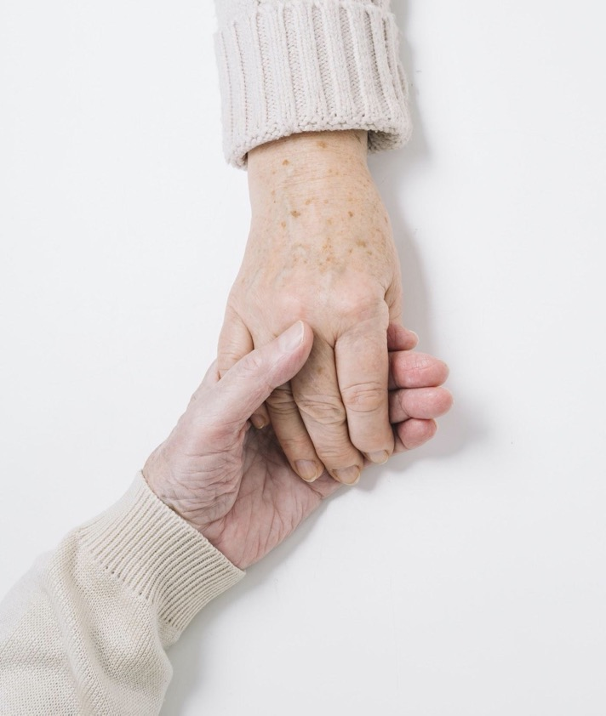
Thank You!
Do you have any questions?
Ann Choryan Bilbrey, PhD
ann@optimalagingcenter.com

