Slide 1
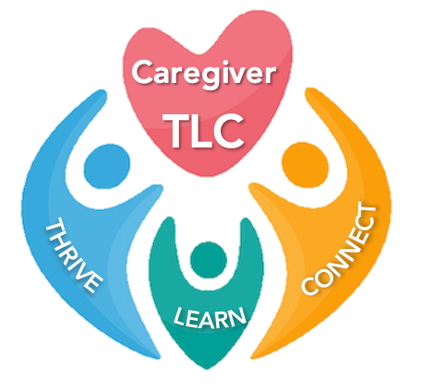

ALL BY MYSELF
Caregiver TLC is a derivative of the Coping With Caregiving 2.0 Suite
Notes:
Handouts
Making it Personal: An Action Plan for the Future
Rev 2023 AB

Slide 2

Deep
Breathing
Take 10 deep breaths
Let Go of the Outside World and Focus on the Here and Now

Slide 3

Check In
Deep Breathing
Anger-Mapping
S.T.O.P.

Slide 4



Today’s Topics
Meaningful
Connections
Review
Celebration

Slide 5

Meaningful Connections Matter
Social connectedness is important to staying healthy and happy.
These meaningful connections help to prevent loneliness
There are multiple methods to foster feeling connected to others

Slide 6
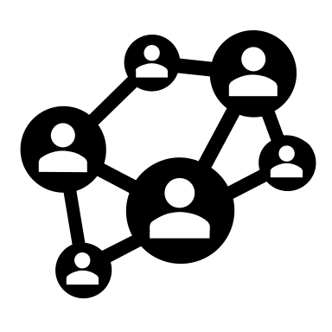
Creating Social Connectedness
Create a Support Network
Friends, family, peers, professionals
WHY:
This network helps you to feel connected and less on your own
CAUTION:
Diversify! Don’t depend on just one connection point. The more connection points you have the better it can weather any disruptions.

Slide 7
Where to go in a Crisis: Helplines / Hotlines
WHAT:
Non-judgmental listening services for people in crisis
Offered by telephone, may also be email, web or text support
Can also offer access to information, services, and advice
WHY:
Sometimes it can be very freeing to talk with someone who is completely objective
Most are 24/7, so in the dead of the night when you are laying awake worrying it is nice to have someone to talk with
CAUTION:
You are not guaranteed to talk to the same person every time

Slide 8
Helplines for Caregivers
Institute on Aging Friendship Line (800-971-0016)
24-hour toll-free Friendship Line
Founded in 1973, it is the only accredited crisis line in the country for people aged 60 years and older, and adults living with disabilities
Alzheimer’s Association 24/7 Helpline (800-272-3900)
24/7, 365 days a year
Specialists and master’s-level clinicians offer confidential support and information to people living with the disease, caregivers, families and the public
live chat from https://www.alz.org/help-support/resources/helpline
  available from 7a.m.-7p.m. (CST) Monday through Friday
Caregiver Help Desk (855-227-3640)
Caregiving experts are available 8:00 AM – 7:00 PM ET.
Hosted by Caregiver Action Network and staffed by caregiving experts, helps caregivers to find the right information needed to help navigate complex caregiving challenges.
Live chat/email available from https://caregiveraction.org/
Check website of specific chronic illness foundations/associations.

Slide 9
Support Groups
WHAT:
Support groups focus on sharing personal experiences and feelings, coping strategies, or firsthand information
WHY:
Feel less alone
Source of practical advice
CAUTION:
You may need to try out a variety of support groups until you find one that fits you

Slide 10


Support Groups: Pros and Cons
Pros:
Feeling less lonely or isolated
Improving skills to cope with challenges
Improving understanding of a disease
Learning about health, economic or social resources
Cons:
Not helpful for everyone
Many groups do not do problem solving
Some can end up leaving you feeling worse than when you arrived
No way of knowing if material offered is evidence-based

Slide 11

Finding One That Fits
Understand the Format
Manage Expectations
Cost Involved
Don’t Have to Stay
Keep an Open Mind

Slide 12
Where to Find a Support Group
Family Caregiver Alliance offers an emailing list style support for caregivers caring for persons with all types of chronic illnesses https://www.caregiver.org/connecting-caregivers/support-groups/
  Well Spouse Association open for all chronic illnesses https://wellspouse.org/
Looking for something local and in-person?
  Check out the major organizations for the illness of the person you are caring for
  American Heart Association https://www.stroke.org/en/stroke-support-group-finder
    Michael J Fox Foundation https://www.michaeljfox.org/news/support-groups
Alzheimer’s Association https://www.alz.org/events/event_search
Lewy Body Dementia Association https://www.lbda.org/local-support-groups/
Find your local Area on Aging
  https://www.n4a.org/

Slide 13
Online Message Boards
WHAT:
Online message boards serves the same goals of a support group without the structure of attending a once a week ‘event’
Available 24/7 you post your question or share an answer on your schedule
WHY:
Along with feeling less alone & being a source of practical advice online message boards are available when you need them
CAUTION:
You don’t know who is offering the advice so make sure you verify the information before you use it!

Slide 14
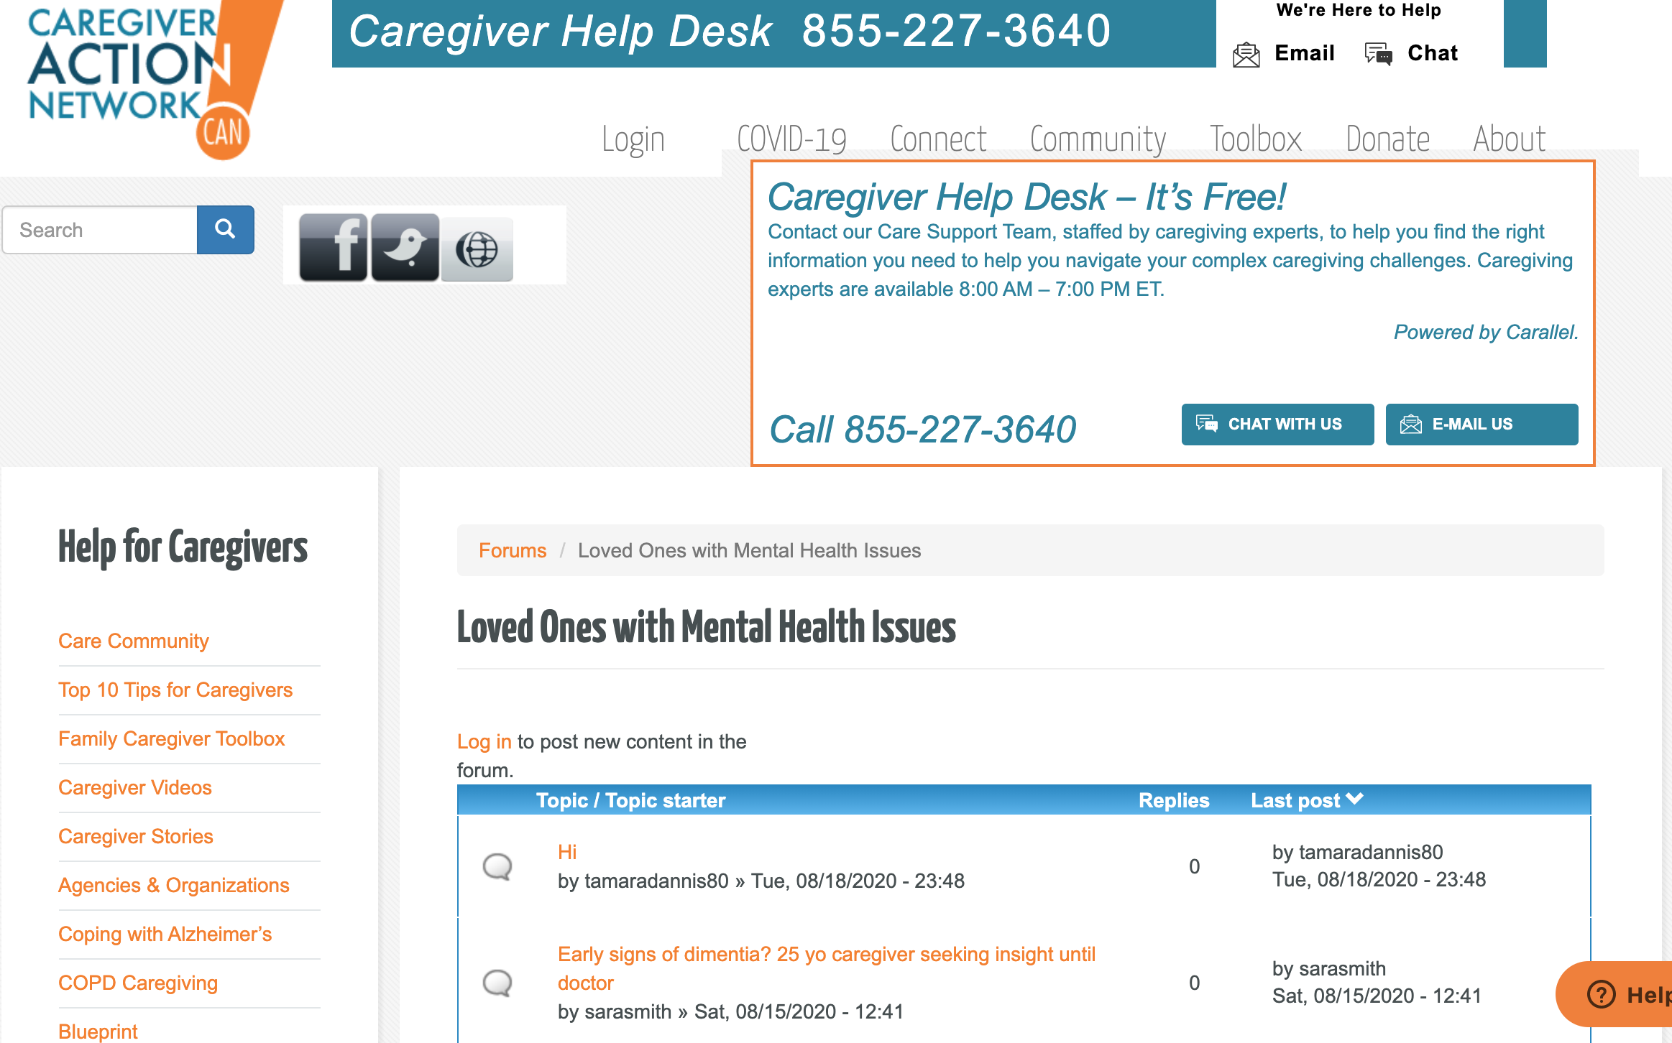
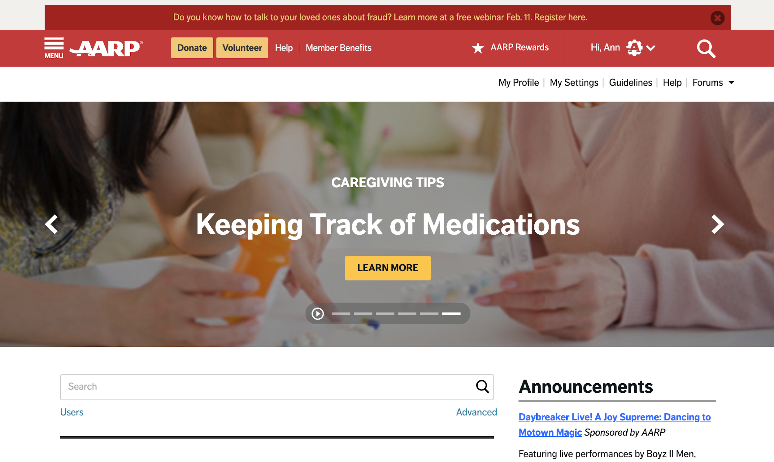
Message Boards
ALZ Connected
(Alzheimer’s Association)
Alzheimer’s and other Dementias
Patients, CGs, Family, Friends, and others
https://www.alzconnected.org/
Care Community
(Caregiver Action Network)
Browse without signing up, however if you wish to post you will need to
Specific forums for Alzheimer’s, Huntington’s, Parkinson’s, & COPD, plus more general online forums
https://caregiveraction.org/community
AARP Online Community
(AARP)
For all caregivers
Don’t have to be a member
Variety of forums including a set specifically for caregivers – caregiver tips, knowledge base articles, chat, plus more
https://community.aarp.org/
Smart Patients
(Family Caregiving Alliance / Smart Patients)
For caregivers of adults with chronic physical or cognitive conditions
https://www.smartpatients.com/partners/fca

Slide 15

Social Media - Facebook
WHAT:
Facebook has many private support groups, some have been around for years
Providing support & advice, many caregivers find them very helpful
WHY:
Facebook is a media that many are already familiar with
CAUTION:
There is no guarantee of privacy on Facebook. While these groups do make an effort to protect their members, the very nature of Facebook can at times work against them

Slide 16
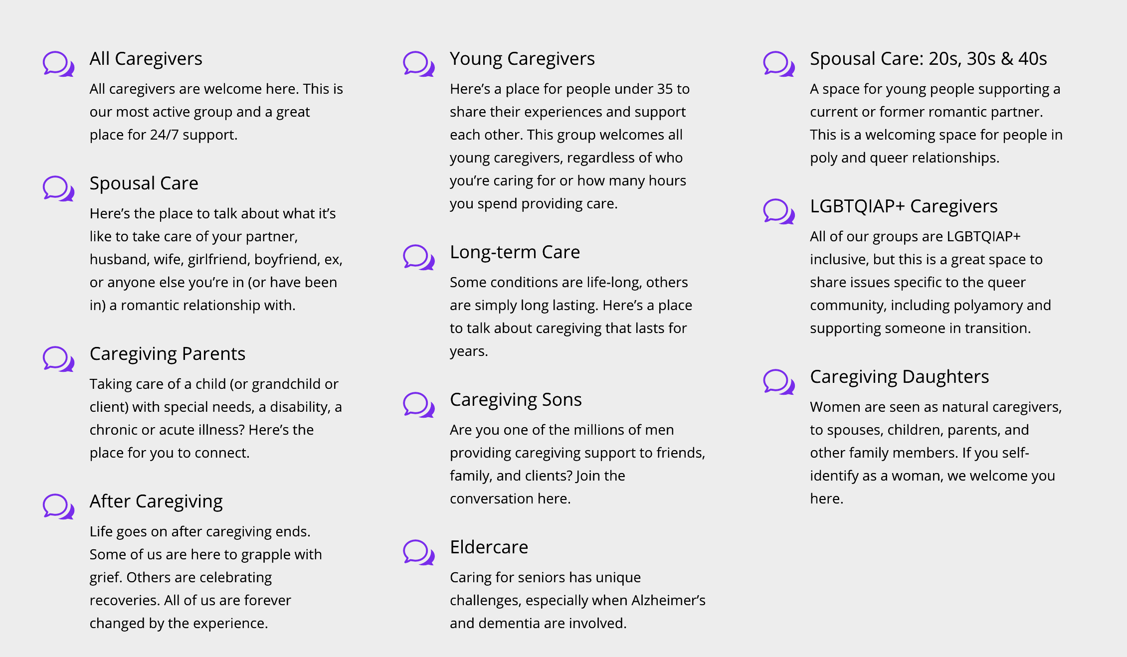
Facebook Caregiver Groups for All Caregivers
Caregiver Nation
This is a group for family caregivers. We share information, understanding, empathy, and resources so that caregivers never feel alone or unsupported in their efforts.
https://www.facebook.com/groups/122999778390804
Working Daughter
This is for women who are balancing caring for an aging parent with their career. Join us for community, support, encouragement. Share your questions and your best advice.
https://www.facebook.com/groups/workingdaughter/
The Caregiver Space Community offers a variety of private Facebook groups
These private Facebook groups are part of Caregiver Space.org and open to any caregiver providing care and are specific.
https://thecaregiverspace.org/

Slide 17
Facebook Caregiver Groups for Dementia
Memory People
They bring real-time Support to patients, caregivers, advocates, family members and professionals who are dealing with Alzheimer's/dementia or any memory impairment.
https://www.facebook.com/groups/180666768616259?ref=pages_group_cta
The Purple Sherpa Basecamp:
Dementia Family Caregiver Support Group
This is a place to share what we've learned as care-partners, to vent and support one another, and to break the silence that leaves so many caregivers feeling alone.
https://www.facebook.com/groups/ThePurpleSherpaBasecamp/

Slide 18




Review: Stress Management
Stress affects our life in many ways, some of them unexpected.
Everyone shows stress in different ways, and it is important to know your own signals.
Deep breathing & visualization works best if it is practiced often.
Skills learned:
Deep Breathing
Visualization

Slide 19




Review: Mood Management
Depressive symptoms are common during caregiving. Taking the time to enjoy yourself will help you feel less stressed and a better CG.
Scheduling and then doing positive activities can help to manage mood.
It is important to do the scheduled activity, even if you don’t feel like it. Make a plan and do the plan – trust in the process.
Skill learned:
Positive Activities

Slide 20


Review: Nurturing Resilience
The ability to bounce back from a crisis is something you can work on and make better
Rewiring your brain to look for the positive can increase your sense of well-being
Identifying your care team will help you to: appreciate what is working well, plan for future difficulties, manage the people involved, identify missing people and services and communicate with everyone.
Skills learned:
Focusing on the Positive
Atlas CareMap

Slide 21

Review: Self-Care
CGs are at an increased risk for certain health concerns and burnout.
Self-Care is a deliberate action you take that improves your physical, mental, or emotional well-being.
Understanding what keeps you from doing self-care can help you to increase the amount of self-care you do.
Prioritizing addressing health concerns, finding support, practicing self-compassion, and adding laughter is a good start on adding self-care to my day.
Skills learned:
Knowledge of their own participation in self-care
Broadening their engagement in self-care

Slide 22


Review: Coping with Frustration
Both positive and negative emotions are a normal part of caregiving.
Emotions are one part how you feel, one part how your body reacts, one part how you behave.
There are different ways to proceed dependent on how angry you are.
Stop, Take ten breaths, Observe, and Proceed can help to give you space to respond rather than react when you are angry.
Skills learned:
Anger Mapping
Awareness of self-talk
S.T.O.P.

Slide 23


Review: Finding Support
Social connectedness is important to staying healthy and happy.
These meaningful connections help to prevent loneliness
There are multiple methods to foster feeling connected to others
Skills learned:
Methods of finding support online

Slide 24

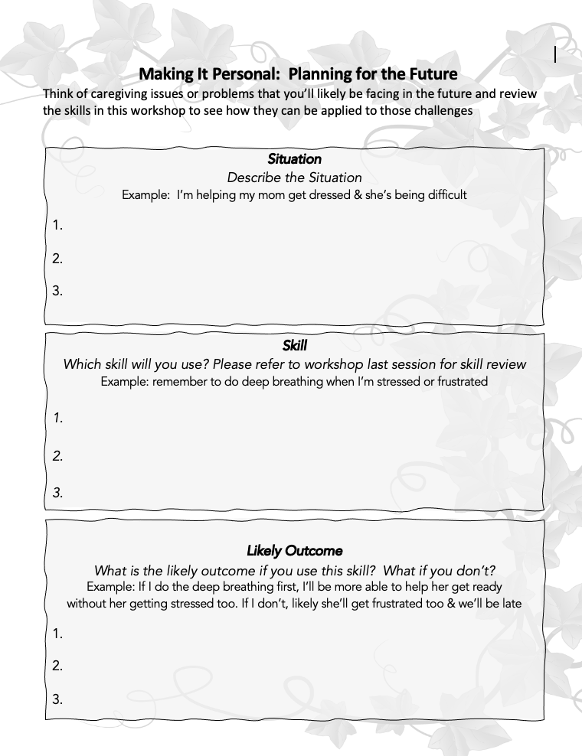












Making it Personal: Planning for the Future
Deep Breathing
Three Paths
Visualization
Self-Care List
Anger-Mapping
Positive Activities
Online Connections
Self-Talk
S.T.O.P.
Atlas CareMap

Slide 25
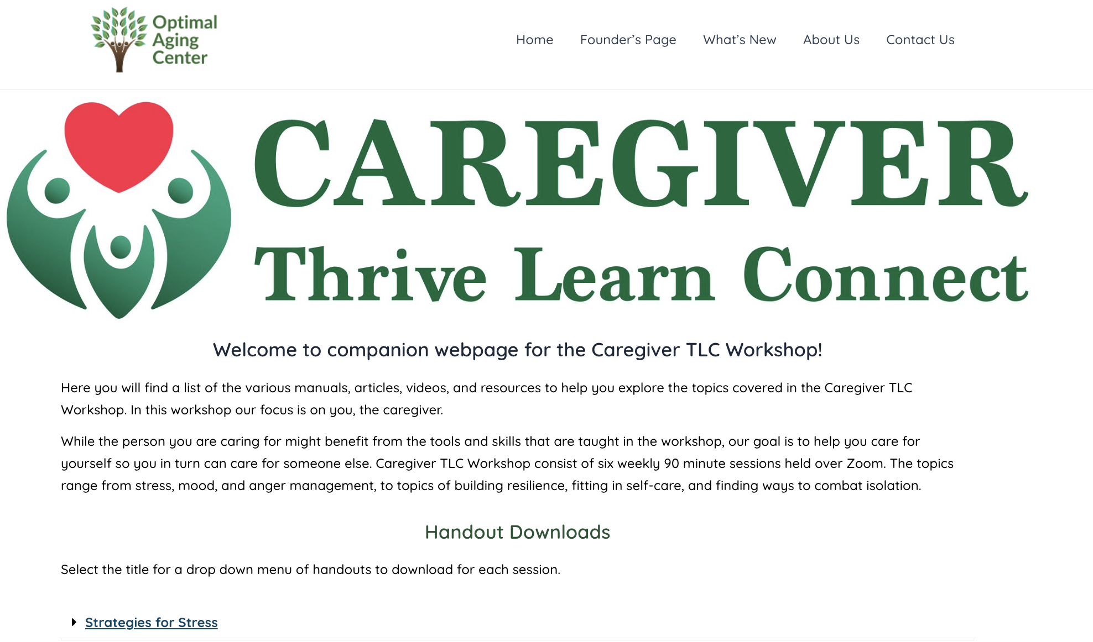
Access
To The
Website
URL: https://www.optimalagingcenter.com/caregiver-tlc/
Notes:
Contents: Handouts include pdf of slide set, and supplemental educational material sorted by session and topic.

Slide 26

CONGRATULATIONS!

Slide 27
Put Image of Certificates Here [remove text] new slide>duplicate slide>drag image to slide

