Slide 1


Coping with Frustration
Caregiver TLC is a derivative of the Coping With Caregiving 2.0 Suite
Notes:
Handouts
OAC: Anger Mapping
OAC: S.T.O.P.
Rev 5.1.23 AB

Slide 2

Deep
Breathing
Take 10 deep breaths
Let Go of the Outside World and Focus on the Here and Now

Slide 3


Check In
Self-Care List
Top Three

Slide 4



Today’s Topics
Negative
Emotions
Recognizing
Intensity
Strategies
for Managing

Slide 5


Emotions
Sad
Guilt
Happy
Anger
Joy
Emotions
Frustration
Love
Hope

Slide 6


I shouldn’t have said/done that!
Everyone reacts in different ways
  Genetics
  Biology
  Environmental
  Situational
Emotions themselves just are - they are not bad or good

Slide 7



Three Parts to Emotion
How you
feel
How your
body reacts
How you
behave

Slide 8
Range of Anger
FURIOUS
ANGRY
FRUSTRATED
UPSET
ANNOYED
CALM
no
strong emotion
slightly
angry or irritated
unhappy,
disappointed
or worried
upset because
you can’t change
something
strong feeling- someone did you wrong
wild,
intense
anger

Slide 9
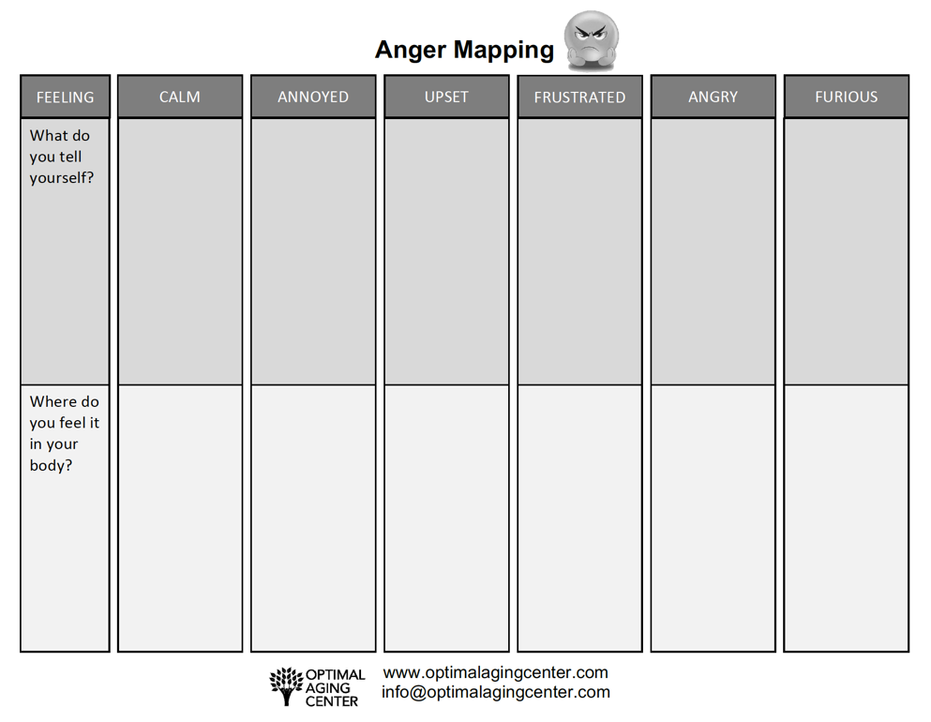




How Do You Know?

Slide 10
Taking 10 Breaths
Giving you space to respond rather than react
FIRST TIME
Sit comfortably in a chair and close your eyes. Notice your breathing. Just observe your own breath for a couple of breaths.
STEP 1: SLOW
Breath in through your nose for a count of 5, pause
Breath out through your mouth for a count of 5
STEP 2: TAKE 10
Continue this practice for at least 10 breath cycles (in/out).
STEP 3: REPEAT
If still upset, do another 10 breaths.

Slide 11

Self Talk
What we tell our self when we are angry is powerful
It can mean the difference between handling your anger well or not
It is important to be aware of what you tell yourself
I can’t do this anymore!
He is doing this on purpose.
I’m a horrible caregiver!

Slide 12

STOP
S
T
O
P
Stop
Take 10 Breaths
Observe: What’s happening in me?
Proceed Differently

Slide 13
Proceeding Differently
Annoyed or upset?
Change the self-talk
Find the humor in the situation
Frustrated?
Change the self-talk
Take 10 breaths
Angry or furious?
Walk away
Take 10 breaths
Exercise your anger away
Wait to re-engage until calmer

Slide 14
Take Away
Both positive and negative emotions are a normal part of caregiving.
Emotions are one part how you feel, one part how your body reacts, one part how you behave.
There are different ways to proceed dependent on how angry you are.
Stop, Take ten breaths, Observe, and Proceed can help to give you space to respond rather than react when you are angry.

Slide 15

Making This Work for You
Pick One
Deep Breathing
Practice taking
10 breaths daily.
Anger-Mapping
Become aware of
your self-talk. Track it for one week and practice finding alternatives.
S.T.O.P.
Use S.T.O.P. during a situation where you are mildly or moderately angry.
Set a Deadline
Why this one?
What will you pair it with?
Optional
Break it Down
Reminders
Run into Problems
Getting it Done?
Be realistic in your deadline.
How will this help you?
Do it with something you already do.
Take large tasks & break it into steps.
Phone Alarms
Post-Its
Tape to Mirror
ID the issue
Brainstorm solutions
Try it out

Slide 16
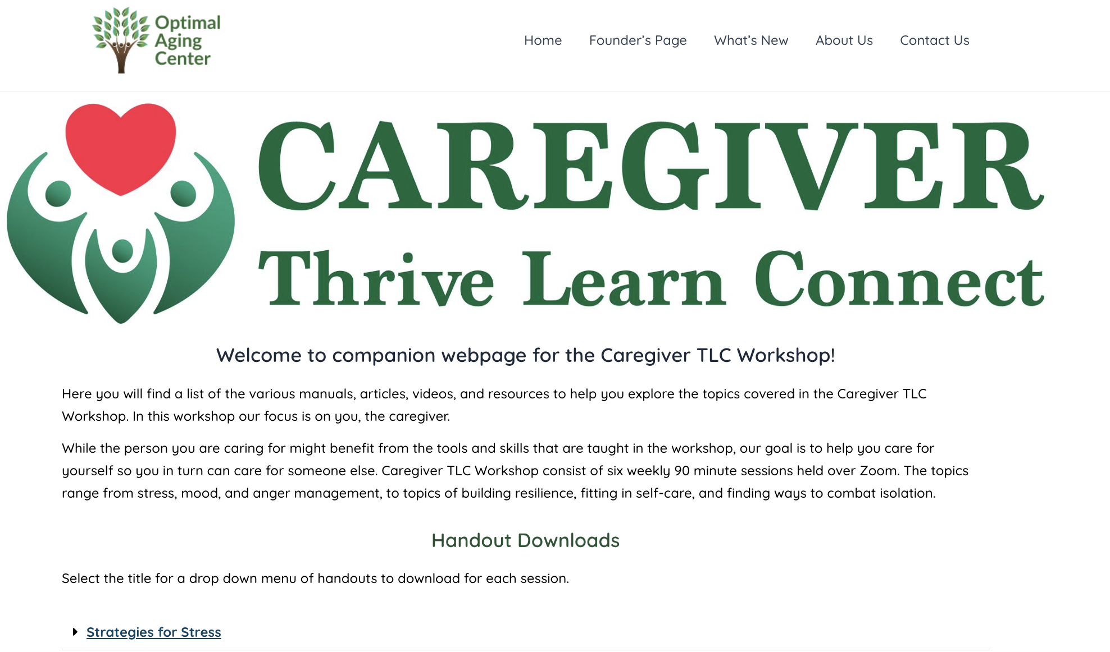
Access
To The
Website
URL: https://www.optimalagingcenter.com/caregiver-tlc/
Notes:
Contents: Handouts include pdf of slide set, and supplemental educational material sorted by session and topic.

