Slide 1


Filling the Well
Caregiver TLC is a derivative of the Coping With Caregiving 2.0 Suite
Notes:
Handouts
NIH: A Good Night’s Sleep
OAC: Self-Care Checklist
Rev 5.8.23 AB

Slide 2

Deep
Breathing
Take 10 deep breaths
Let Go of the Outside World and Focus on the Here and Now

Slide 3


Check In
Three Paths
Atlas CareMap

Slide 4



Today’s Topics
Caregiver
Burnout
Self-Care
Tips &
Strategies

Slide 5

Let’s Start with the Elephant in the Room
“I have no time.”
“I have no help.”
“I’m just too tired.”
“I just can’t.”
“I can’t afford it.”

Slide 6

Caregiving &Well-being
Love
Commitment
Giving Back
Very Rewarding
Worry
Exhaustion
Continuous Care
Inadequate Resources

Slide 7
Caregiving is Intense
Signs of
Caregiver Burnout
Uncharacteristic Irritability & Impatience
Poor Sleep
Forgetfulness
Physical Symptoms: headaches gastrointestinal distress
Decreased appetite
Increase food intake
Drinking alcohol too much
Increase drug usage
Isolating
Lack of interest in doing things you use to enjoy
Getting sick all the time
Feeling anxious or depressed all the time
Thoughts of hurting yourself or the person you are caring for
Heavy Workload
Conflicting Demands
Lack of Privacy
Change of Roles
Unreasonable Demands
Unrealistic Expectations

Slide 8

Self-Care
A deliberate action
Provides a buffer between you and feeling overwhelmed or stressed
Gives energy to care for someone else
You can’t get water from an empty well
Self-care is not a luxury – it is a necessity!

Slide 9
Four Areas of Self- Care
Physical
care for your body
Schedule a doctor appt Take a daily walk Try chair yoga Eat more veggies
Mental
exercising your mind
Listen to a pod cast Do a puzzle or play a game Use your non-dominant hand Draw a map of your neighborhood
Spiritual
meaningful action
Say a prayer Spend time in nature Help someone else Mediation
Social
reaching out to others
Call a friend Unfollow a negative person on Facebook Join a support group Greet a neighbor on your walk

Slide 10
Quality Sleep
Poor sleep affects us in multiple ways
  It becomes harder to focus and pay attention
  Slows reaction time, making for dangerous driving & other safety related risks
  Affects problem solving abilities
  Without enough quality sleep can become more forgetful
During sleep
  Memories are reactivated
  Connections between brain cells are strengthened
  Information is transferred from short to long-term
Caregiving interrupts sleep in many ways

Slide 11

How Much Sleep do You Need?
Optimal Aging Center

Slide 12
Sleep Hygiene
It’s just another way of saying good sleep habits
Think of it as preparing yourself for for the best sleep you can get
  Avoid long naps
  Stick to a schedule
  Play in the sunlight
  Get moving
  Restrict what you eat and drink
  Banish electronics
  Try a warm bath
  Wear warm socks
  No difficult discussions

Slide 13
Why No Naps?
Sleep Drive
Lowest in the morning after wakening
Increases during the day
Naps weaken sleep drive and make it harder to fall asleep

Slide 14
Benefits of Staying Active
Stress reduction
Better sleep
Improved mood
More energy
Heart disease, stroke, and other disease prevention
Improved memory
Reduction in blood pressure
Increased metabolism
GOAL: 150 mins moderate intensity aerobic activity

Slide 15
Overcoming Barriers to Staying Active
Finding Time
  Combine focused activity with a task already part of your day
  30 mins too long? Break into three 10 min segments
  Can’t do 150 minutes? Some activity is still better than none
Sticking with the Plan
  Mix it up – add new activities from each category
  Find a buddy
Too Tired to Stay Active?
  Increase in energy is one of the many benefits of staying active
  Sometimes you just have to make the plan and “just do it” for a few weeks
  Continuing to feel fatigue after a few weeks? Check in with your doctor
Optimal Aging Center

Slide 16
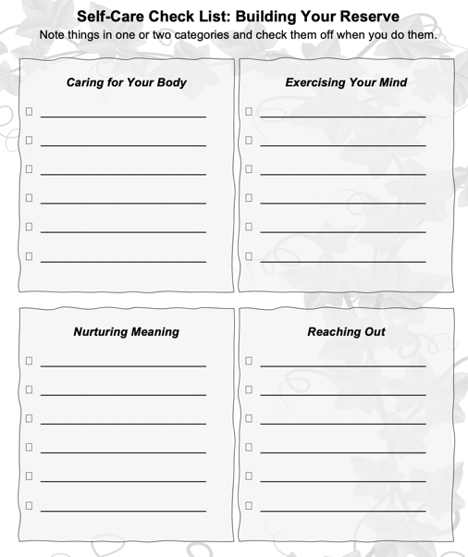
Self-Care Check List
When you are trying to start a new habit, it is good to write down your intentions and post them where you can see them every day
Write down what you want to do
Then check it off when the task is done

Slide 17


What Stops
You From
Self-Care?
Identify attitude or beliefs
Negative Self-Talk

Slide 18

Address Your Health Issues
Find a Support Group
Practice Self-Compassion
Laugh

Slide 19
Take Away
Caregivers are at an increased risk for certain health concerns and burnout.
Self-Care is a deliberate action you take that improves your physical, mental, or emotional well-being.
Understanding what keeps you from doing self-care can help you to increase the amount of self-care you do.
Prioritizing addressing health concerns, finding support, practicing self-compassion, and adding laughter is a good start on adding self-care to my day.

Slide 20


Making This Work for You
Pick One
Identify Areas to Work On
Use the Self-Care Check List to identify the things you currently do for self-care. Notice which areas you are doing well
in and which areas you need to
work on.
Practice the Top Three
Make a list of your top 3 self-care activities and practice one a day. If needed,
break into smaller tasks.
Set a Deadline
Why this one?
What will you pair it with?
Optional
Break it Down
Reminders
Run into Problems
Getting it Done?
Be realistic in your deadline.
How will this help you?
Do it with something you already do.
Take large tasks & break it into steps.
Phone Alarms
Post-Its
Tape to Mirror
ID the issue
Brainstorm solutions
Try it out

Slide 21
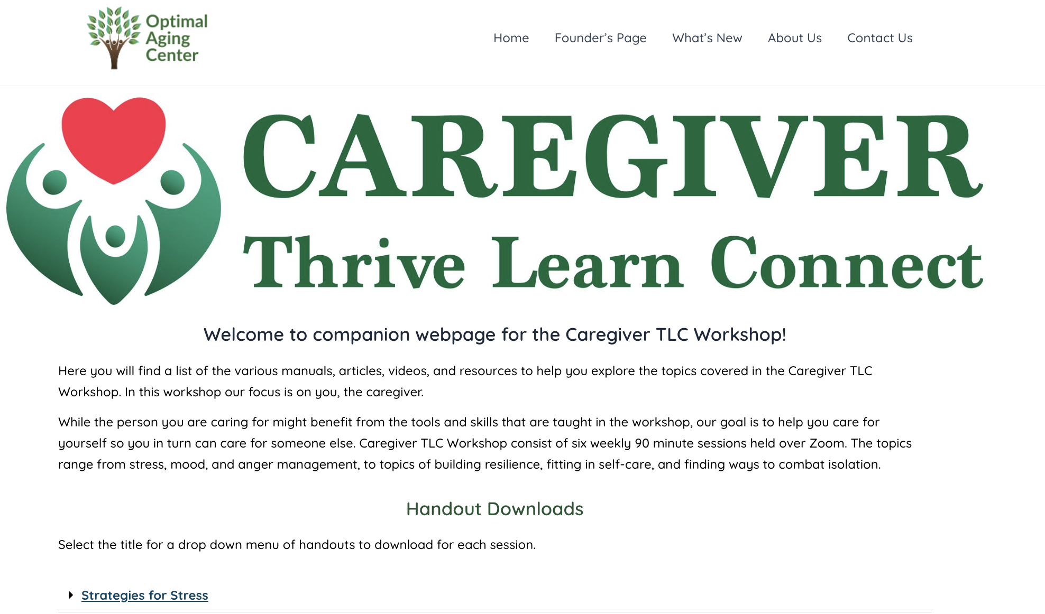
Access
To The
Website
URL: https://www.optimalagingcenter.com/caregiver-tlc/
Notes:
Contents: Handouts include pdf of slide set, and supplemental educational material sorted by session and topic.

