Slide 1


Strategies for Stress
Caregiver TLC is a derivative of the Coping With Caregiving 2.0 Suite
Notes:
Handouts
Deep Breathing
Mapping Your Stress
Visualization Guide
Rev 5.8.23 AB

Slide 2





Building Community
TIME
PARTICIPATION
90 minutes long
May need to interrupt
Is voluntary but,
Best way to learn
PRIVACY
SURROUNDINGS
Said in the group,
Stays in the group
Check screen visibility,
Reduce noise
IF DUTY CALLS
Leave to do what you need
Come back when you can

Slide 3

Introductions
Your Name
One thing you hope to learn from this workshop
Who you are caring for and their diagnosis

Slide 4
Today’s Topics
Stress &
Caregiving
Recognizing
Stress
Relaxation
Skills

Slide 5
Stress & Caregiving
Caregiving over a long period of time takes a toll on your physical and emotional state
Caregiving’s unique challenges that often increase stress
Chronic stress impacts health & well-being
What stresses out you may not stress out another

Slide 6
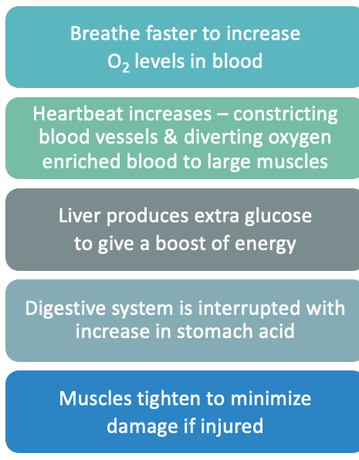
Stress
Your body's response to threat
  Physical
  Emotional
  Mental
Stress can be:
  Acute: over quickly
  Chronic: lasting a long time
  Can be growth promoting
Chronic stress affects us:
  Physically
  Psychologically
  Socially

Slide 7
Consequences of Stress
PHYSICAL
PSYCHOLOGICAL
SOCIAL
health related
emotional/mental
relationships
high blood pressure
heart problems
increased chance to catch colds and flu
depression / anxiety
anger / irritation
changes in appetite
sleep problems
lack of energy
hopelessness / helplessness
withdraw
may feel like burden
increases loneliness
friends and family can drift away

Slide 8
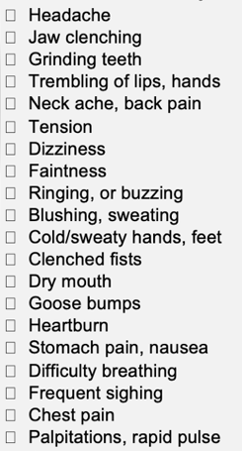
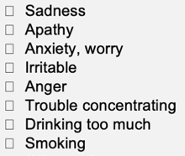
Your Stress Signs
Everyone reacts to stress differently
Need to know your signs so you know when to react
  Think about a recent stressful experience
  Scan your body – where are you experiencing that stress?
  Use the handout to learn what your stress signs are
Over the next week
  Pay attention to your stress signs

Slide 9

Dealing with Stress: Deep Breathing
Proven method to calm down and reduce stress
  Sends a message to your body to relax and be calm
  Slowing down your breathing
  Your heart rate and breathing slows
  Gives you space to respond rather than react
Daily practice
  Start with 10 breathes
  Use during a stressful caregiving situation
Goal is to have it be second nature to you
so you don't need to think about it, just use
it when you find yourself in a stressful situation

Slide 10
In a moment we will do an exercise that will ask you to slowly breath in for a count of 5, pause, and then breath out for a count of 5.
If you have any breathing problems (like asthma or COPD) or other health conditions that make you uncomfortable doing this, please don’t push yourself.
If you get lightheaded, stop immediately!

Slide 11
Deep Breathing Guide
Giving you space to respond rather than react
STEP 1: WATCH
Get comfortable and close your eyes
Just feel your breath for a couple of breaths
STEP 2: SLOW
Breath in through your nose for a count of 5, pause
Breath out through your mouth for a count of 5
STEP 3: DEEP
Put your hand on your stomach
Feel your hand rise as you breath in and fall as you breath out
STEP 4: FOCUS
Difficulties focusing?
Add a word as you breath in and another as you breath out
STEP 5: PRACTICE
Practice every day
Take 10 breaths

Slide 12


Dealing with Stress: Visualization
Visualization is a way to help you to take a break from stress
  It involves imagining yourself in a peaceful and safe place where you feel relaxed, happy, and secure
Daily practice
  Works best if you practice it daily, until it becomes second nature
Goal is to have it be second nature to you, so you don't need to think about it just use it when you find yourself in a stressful situation

Slide 13
Visualization Guide
Imagine a place where you can feel calm, peaceful and safe. It may be a place you've been to before, somewhere you've dreamt about going, or maybe somewhere you've seen a picture of.
Focus on the COLORS in your peaceful safe place.
Now notice the SOUNDS that are around you, or perhaps the silence.
Think about any SMELLS you notice there.
Then focus on any skin SENSATIONS - the earth beneath you, the temperature, movement of air, anything you can touch.
While you are in your peaceful and safe place, you might choose to give it a name, whether one word or a phrase that you can use to bring this image back, anytime you need to.
You can choose to linger there a while, just enjoying the peacefulness and serenity.
You can leave whenever you want to, just by opening your eyes and being aware of where you are now.

Slide 14
Take Away
Stress affects our life in many ways, some of them unexpected.
Everyone shows stress in different ways, and it is important to know your own signals.
Deep breathing & visualization work best if it is practiced often.

Slide 15



Making This Work for You
Pick One
Daily practice of deep breathing (start at 10 breaths)
Daily practice of visualization
(5 mins daily)
Set a Deadline
Why this one?
What will you pair it with?
Optional
Break it Down
Reminders
Run into Problems
Getting it Done?
Be realistic in your deadline.
How will this help you?
Do it with something you already do.
Take large tasks & break it into steps.
Phone Alarms
Post-Its
Tape to Mirror
ID the issue
Brainstorm solutions
Try it out

Slide 16
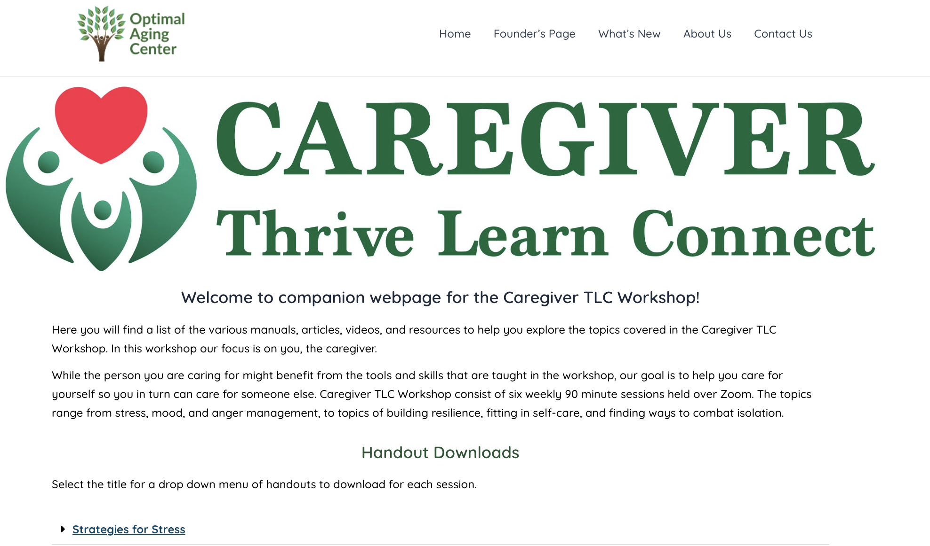
Access
To The
Website
URL: https://www.optimalagingcenter.com/caregiver-tlc/
Notes:
Contents: Handouts include pdf of slide set, and supplemental educational material sorted by session and topic.

